Slide 1


Health Level Seven Reference Models
Abdul-Malik Shakir
Principal Consultant, Shakir Consulting
HL7 Educational Summit, Chicago, IL
March 2008

Slide 2
About Me
Abdul-Malik Shakir
Principal Consultant, Shakir Consulting, La Verne, CA
HL7 Member since 1991
Principal Consultant with Shakir Consulting
Chief Technical Architect with Cal2Cal Corporation
Co-Chair of the HL7 Education Committee
Member of the HL7 Architectural Review Board
Member of the HL7 Public Health and Emergency Response Committee
Member of the HL7 Regulated Clinical Research Information Management Committee
Member of the HL7 Modeling and Methodology Committee

Slide 3
Session Outline
Part I
Background
  Foundational Artifacts
Reference Information Model
  History
  Harmonization Process
  Unified Service Action Model
  Core Classes, Attributes, and Value Sets
Part II
Data Types
  Categories
  Attribute Types
  Class Diagram
Vocabulary
  Metamodel
  Binding
  Structural Attributes

Slide 4
HL7 v3.0 Foundational Artifacts
Reference Models
Reference
Information
Model
The HL7 Reference Information Model is the information model from which all other information models and message specifications are derived.
Datatype
Specification
The HL7 Datatype Specification defines the structural format of the data carried in an attribute and influences the set of allowable values an attribute may assume.
Vocabulary
Specification
The HL7 Vocabulary Specification defines the set of all concepts that can be taken as valid values in an instance of a coded attribute or data type property.

Slide 5
HL7 Version 3.0 Reference Models
Reference Information Model
Data Type
Specification
Vocabulary
Specification

Slide 6
HL7 Version 3.0 Normative Foundation
The HL7 reference models are the foundational artifacts of HL7 version 3.0
The Reference Information Model (RIM) and Data Type Specification are independent normative specifications
Only vocabulary specifications referenced by normative specifications are normative; they are not balloted independently
All HL7 version 3.0 specifications are derived from the v3 reference models; all HL7 specifications derived from the v3 reference models are version 3.0 specifications
The HL7 v3.0 reference models are maintained collaboratively by three HL7 technical committees:
  RIM – Modeling & Methodology Technical Committee
  Data Types – Infrastructure and Messaging Technical Committee
  Vocabulary – Vocabulary Technical Committee

Slide 7
HL7 Version 3.0
Reference Information Model
The HL7 Reference Information Model is the information model from which all other information models and message specifications are derived.

Slide 8
The HL7 Reference Information Model
The HL7 Reference Information Model (RIM) is a static model of health and health care information as viewed within the scope of HL7 standards development activities.
It is the combined consensus view of information from the perspective of the HL7 working group and the HL7 international affiliates.
The RIM is the ultimate source from which the information-related content of all HL7 version 3.0 protocol specification standards is drawn.
The RIM is modeled using the modeling syntax defined by the Object Management Group’s Unified Modeling Language (UML).
UML is a graphical language for visualizing, specifying, constructing, and documenting the artifacts of a software-intensive system.

Slide 9
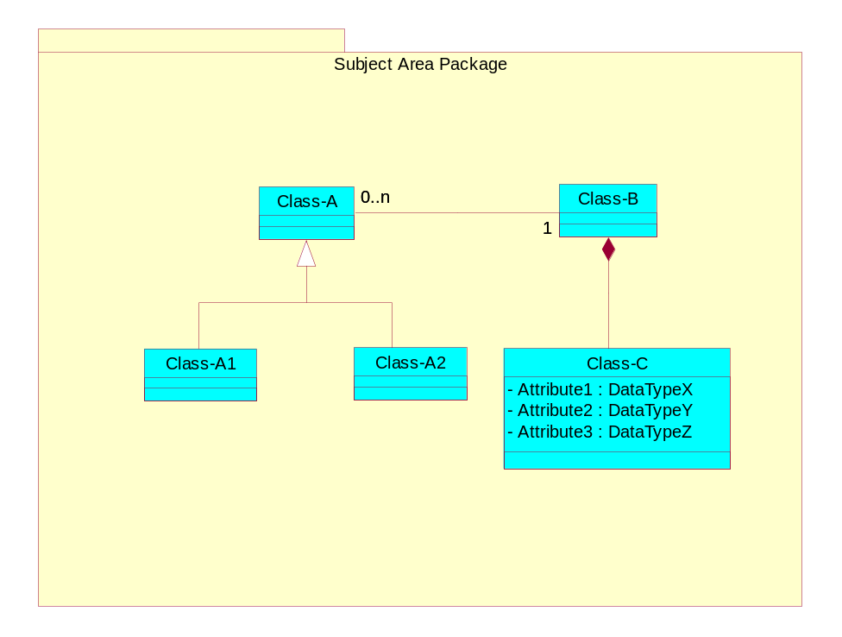
Components of an UML Class Diagram
Package
  A collection of related classes
Class
  Something about which information is maintained
Attribute
  An element of information pertaining to a class
Data Type
  A specification of the structure and value constraint for an attribute
Relationship
  An association between classes

Slide 10

Components of an UML Class Diagram
Package
Class
Relationship
Attribute
Datatype

Slide 11
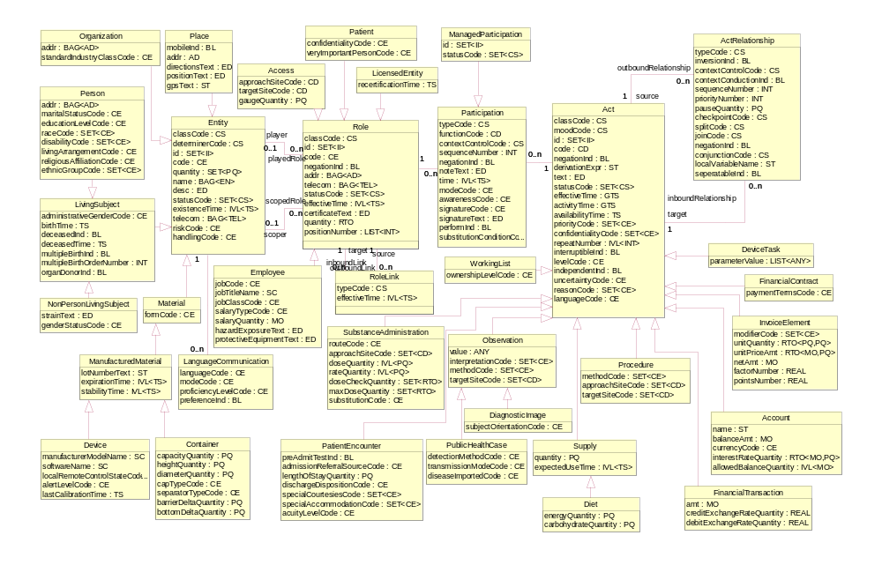
HL7 RIM Class Diagram

Slide 12
Reference Information Model History
Development of the HL7 Reference Information Model began in April 1996.
The first draft of the RIM was created by consolidating data models developed by HL7 Technical Committees, contributed by HL7 Member Organizations, and published by national and international standards organizations and government bodies.
The first release of the RIM (v0.80) was adopted by the HL7 Technical Steering Committee at the January 1997 working group meeting.
The next two working group meetings focused on gaining familiarity with the draft RIM and implementing a process for obtaining and reconciling proposed enhancements to the model.
The RIM maintenance process became known as "RIM harmonization.” The first RIM harmonization meeting was held July 1997 in Indianapolis, Indiana.

Slide 13
RIM Harmonization Process
Change Proposal Preparation
Prepare RIM
Change Proposal
Review RIM
Change Proposal
w/ Stewards
Document Rationale
for not supporting
RIM change proposal
Revise or Withdraw
RIM Proposal
Post RIM Change Proposals
Submit
RIM Change
Proposal
Post RIM
Change Proposal
Notify HL7 Members
of RIM Change
Proposal Posting
Provide Comment
on RIM Change
Proposals
Harmonization Meeting
Discuss the RIM
Change Proposal
Revise, withdraw,
or Table RIM
Change Proposal
Vote on RIM
Change Proposal
Apply Approved
Changes to RIM
Apply Technical
Corrections
Post Harmonization Meeting Review
Present RIM
Harmonization Report
to TSC
Hold TSC and/or
Board Appeals
Finalize
Revised RIM

Slide 14
RIM Harmonization Participants
RIM Harmonization meetings are held three times per year.
Any interested party may attend a RIM harmonization meeting
Only HL7 committees and other accredited standard development organizations may submit change proposals
Only HL7 technical and international committees may vote on proposed changes to the RIM
Only HL7 technical committees may have stewardship over RIM classes
Accredited standards development organizations may vote on proposed changes and hold stewardship over RIM class only if they can demonstrate that their standard specifications are derived from the RIM.

Slide 15
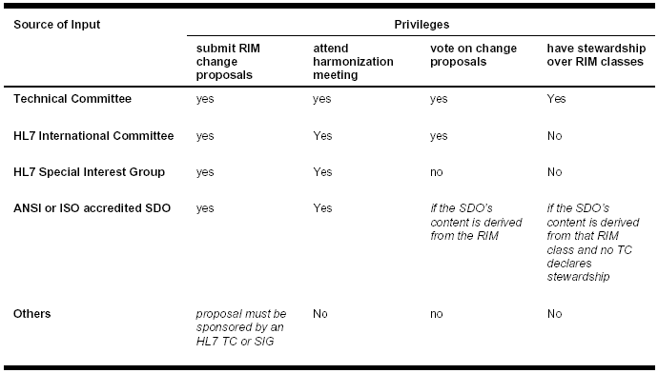
RIM Harmonization Participant Privileges

Slide 16
Major RIM Harmonization Themes
Ensure coverage of HL7 version 2.x. This set of change proposals introduced content to the draft model to ensure that it included all the information content of HL7 version 2.x.
Remove unsubstantiated content from the model. This set of change proposals focused on removing content from the draft model that the steward technical committee did not originate and could find no rationale for retaining.
Unified service action model. This set of change proposals introduced a concise, well-defined set of structures and vocabularies that address the information needs of a wide variety of clinical scenarios. This collection of proposals, known as USAM, involved the combined effort of multiple technical committees.
Ensure quality. This set of change proposals addressed inconsistencies in the draft model and conflicts between the model and the modeling style guide. It began the practice of recording and tracking open issues in the model.
Address the "left hand side" of the model. This set of change proposals introduced powerful structures and vocabularies for the non-clinical portions of the model (patient administration, finance, scheduling). Like the unified service action model, this proposal involved the combined effort of multiple technical committees.

Slide 17
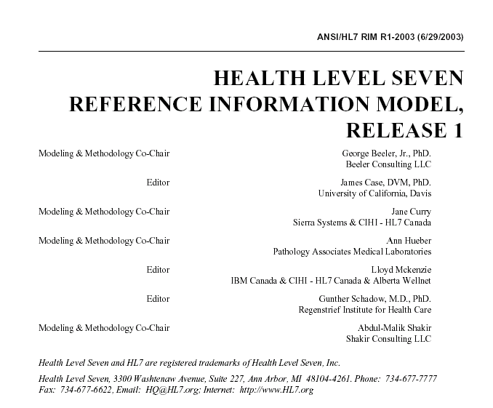
HL7 RIM Normative Specification
Nine harmonization meetings were held between 1998 and 2000 culminating in version 1.0 of the RIM ratified during the January 2001 HL7 Working Group Meeting.
The RIM continues to be refined via ongoing harmonization meeting but has been extremely stable in its content since January 2001.
Version 1.25 of the RIM was submitted for ballot in 2002.
In June 2003 it was published as an American National Standard.

Slide 18
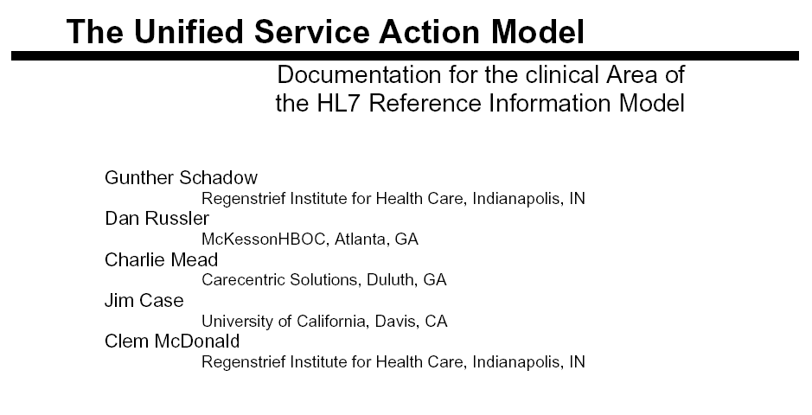

Slide 19
USAM Overview
The Unified Service Action Model (USAM) divides the world into the major categories: Actions (Service,) people (Stakeholder) and things (Material.)
Stakeholders are subjects having legal rights and obligations.
Stakeholder includes both individual Person and Organization.
Material is everything else that has physical existence in space and time.
Material is a large class of all kinds of things, including devices (both durable and disposable equipment), chemicals, food, specimen, and containers, as well as facilities (rooms, beds) and living subjects.

Slide 20
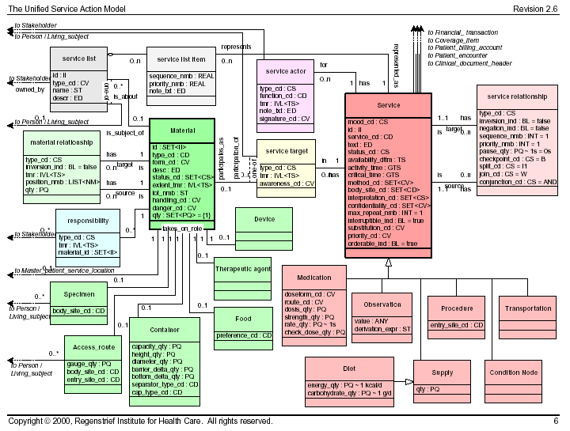
The Unified Service Action Model

Slide 21
USAM’s Influence on the RIM
The Universal Service Action Model (USAM) proposal was a major influence on the current style of the RIM
USAM was a joint project involving multiple HL7 Technical Committees and Special Interest Groups
The USAM Material / Service construct is the predecessor to the current RIM Entity / Act construct
USAM introduced the concept of activity mood as a means of distinguishing between act instances, definition, plans, orders, and criterion.
The RIM concepts of entity determiner and entity roles are based upon concepts first introduced in the USAM proposal.

Slide 22
Entity and Act
Entity
  a physical thing or an organization/group of physical things capable of participating in Acts. This includes living subjects, organizations, material, and places.
Act
  a discernible action of interest in the healthcare domain. An instance of Act is a record of that action. Acts definitions (master files), orders, plans, and performance records (events) are all represented by an instance of Act.
Entity
Act

Slide 23
RIM Core Classes
Entity - a physical thing or an organization/group of physical things capable of participating in Acts. This includes living subjects, organizations, material, and places.
Act – a discernible action of interest in the healthcare domain. An instance of Act is a record of that action. Acts definitions (master files), orders, plans, and performance records (events) are all represented by an instance of Act.
Entity
Act
class_cd : CS
cd: CE
determiner_cd : CS
status_cd : CS
id : II
class_cd : CS
cd: CD
mood_cd : CS
status_cd : CS
effective_time : GTS
id : II
0..*
0..*

Slide 24
RIM Core Classes
Entity
Role
Act
class_cd : CS
cd: CE
determiner_cd : CS
status_cd : CS
id : II
class_cd : CS
cd: CE
effective_time : IVL<TS>
status_cd : CS
id : II
class_cd : CS
cd: CD
mood_cd : CS
status_cd : CS
effective_time : GTS
id : II
1
plays
0..*
0..*
0..*

Slide 25
RIM Core Classes
Role – a classification/specialization of an Entity defined by the relationship of the playing Entity to a scoping Entity. An example of Role is “Employee”. An employee is a classification attributed to a person which has an employment relationship with an organization (Employer).
Entity
Role
Act
class_cd : CS
cd: CE
determiner_cd : CS
status_cd : CS
id : II
0..1
plays
class_cd : CS
cd: CE
effective_time : IVL<TS>
status_cd : CS
id : II
class_cd : CS
cd: CD
mood_cd : CS
status_cd : CS
effective_time : GTS
id : II
0..*
0..*
0..*
0..1
scopes
0..*

Slide 26
RIM Core Classes
Participation – an association between a Role and an Act representing the function assumed by the Role within the context of the Act. A single Role may participate in multiple Acts and a single Act may have multiple participating Roles. A single Participation is always an association between a particular Role and a particular Act.
Entity
Role
Participation
Act
class_cd : CS
cd: CE
determiner_cd : CS
status_cd : CS
id : II
0..1
plays
class_cd : CS
cd: CE
effective_time : IVL<TS>
status_cd : CS
id : II
type_cd : CS
time : IVL<TS>
status_cd : CS
class_cd : CS
cd: CD
mood_cd : CS
status_cd : CS
effective_time : GTS
id : II
0..*
1
1
0..*
0..*
0..1
scopes
0..*

Slide 27
RIM Core Classes
Act relationship – an association between two Acts. This includes Act to Act associations such as collector/component, predecessor/successor, and cause/outcome. The semantics of the association is captured by the Act Relationship attributes.
Act Relationship
type_cd : CS
0..*
0..*
1
1
Entity
Role
Participation
Act
class_cd : CS
cd: CE
determiner_cd : CS
status_cd : CS
id : II
0..1
plays
class_cd : CS
cd: CE
effective_time : IVL<TS>
status_cd : CS
id : II
type_cd : CS
time : IVL<TS>
status_cd : CS
class_cd : CS
cd: CD
mood_cd : CS
status_cd : CS
effective_time : GTS
id : II
0..*
1
1
0..*
0..*
0..1
scopes
0..*

Slide 28
RIM Core Classes
Role Link – An association between two Roles. It is used to capture relationships that exists between Entities other than the scoping relationships. A
single Role may have a Role Link with multiple other Roles. A single Role Link is always between two distinct instances of Role.
Role Link
Act Relationship
type_cd : CS
effective_time : IVL<TS>
type_cd : CS
0..*
0..*
0..*
0..*
1
1
1
1
Entity
Role
Participation
Act
class_cd : CS
cd: CE
determiner_cd : CS
status_cd : CS
id : II
0..1
plays
class_cd : CS
cd: CE
effective_time : IVL<TS>
status_cd : CS
id : II
type_cd : CS
time : IVL<TS>
status_cd : CS
class_cd : CS
cd: CD
mood_cd : CS
status_cd : CS
effective_time : GTS
id : II
0..*
1
1
0..*
0..*
0..1
scopes
0..*

Slide 29
Definition of RIM Core Classes
Act – a discernible action of interest in the healthcare domain. An instance of Act is a record of that action. Acts definitions (master files), orders, plans, and performance records (events) are all represented by an instance of Act.
Act relationship – an association between two Acts. This includes Act to Act associations such as collector/component, predecessor/successor, and cause/outcome. The semantics of the association is captured by the Act Relationship attributes.
Entity - a physical thing or an organization/group of physical things capable of participating in Acts. This includes living subjects, organizations, material, and places.
Participation – an association between a Role and an Act representing the function assumed by the Role within the context of the Act. A single Role may participate in multiple Acts and a single Act may have multiple participating Roles. A single Participation is always an association between a particular Role and a particular Act.
Role – a classification/specialization of an Entity defined by the relationship of the playing Entity to a scoping Entity. An example of Role is “Employee”. An employee is a classification attributed to a person which has an employment relationship with an organization (Employer).
Role Link – An association between two Roles. It is used to capture relationships that exists between Entities other than the scoping relationships. A single Role may have a Role Link with multiple other Roles. A single Role Link is always between two distinct instances of Role.

Slide 30
RIM Backbone Classes
Role Link
Act Relationship
type_cd : CS
effective_time : IVL<TS>
type_cd : CS
0..*
0..*
0..*
0..*
1
1
1
1
Entity
Role
Participation
Act
class_cd : CS
cd: CE
determiner_cd : CS
status_cd : CS
id : II
0..1
plays
class_cd : CS
cd: CE
effective_time : IVL<TS>
status_cd : CS
id : II
type_cd : CS
time : IVL<TS>
status_cd : CS
class_cd : CS
cd: CD
mood_cd : CS
status_cd : CS
effective_time : GTS
id : II
0..*
1
1
0..*
0..*
0..1
scopes
0..*

Slide 31
RIM Backbone Classes
Entity
Role
Participation
Act
class_cd : CS
cd: CE
determiner_cd : CS
status_cd : CS
id : II
0..1
plays
class_cd : CS
cd: CE
effective_time : IVL<TS>
status_cd : CS
id : II
type_cd : CS
time : IVL<TS>
status_cd : CS
class_cd : CS
cd: CD
mood_cd : CS
status_cd : CS
effective_time : GTS
id : II
0..*
1
1
0..*
0..*
0..1
scopes
0..*

Slide 32
RIM Backbone Classes
Entity
Role
Participation
Act
class_cd : CS
cd: CE
determiner_cd : CS
status_cd : CS
id : II
1
plays
class_cd : CS
cd: CE
effective_time : IVL<TS>
status_cd : CS
id : II
type_cd : CS
time : IVL<TS>
status_cd : CS
class_cd : CS
cd: CD
mood_cd : CS
status_cd : CS
effective_time : GTS
id : II
0..*
1
1
0..*
0..*
1
scopes
0..*
Living Subject
Place
Organization
Material
Licensed Entity
Patient
Access
Employee
Managed Participation
Observation
Supply
Patient Encounter
Procedure
Device Task
Substance Administration
Financial Transaction
Invoice Element
Financial Contract
Account
Working List
Control Act

Slide 33

HL7 RIM Class Diagram

Slide 34
RIM Core Attribute Value Sets
Living Subject
Person
Organization
Material
Place
...
Observation
Procedure
Supply
Substance
Admin
Financial
...
Performer
Author
Witness
Subject
Destination
...
Entity
Class Code
Act
Class Code
Participation
Type Code
Entity
Role
Participation
Act
class_cd : CC
determiner_cd : CS
status_cd : CS
cd: CE
0..1
plays
class_cd : CS
effective_time : IVL<TS>
cd: CE
type_cd : CS
time : IVL<TS>
status_cd : CS
class_cd : CC
mood_cd : CS
status_cd : CS
Cd: CD
effective_time : GTS
0..*
1
1
0..*
0..*
0..1
scopes
0..*
Patient
Provider
Employee
Specimen
Certified
Practitioner
...
Definition
Intent
Order
Event
Criterion
...
Entity
Determiner
Code
Kind
Instance
Quantified
Group
Role
Class Code
Act
Mood Code

Slide 35
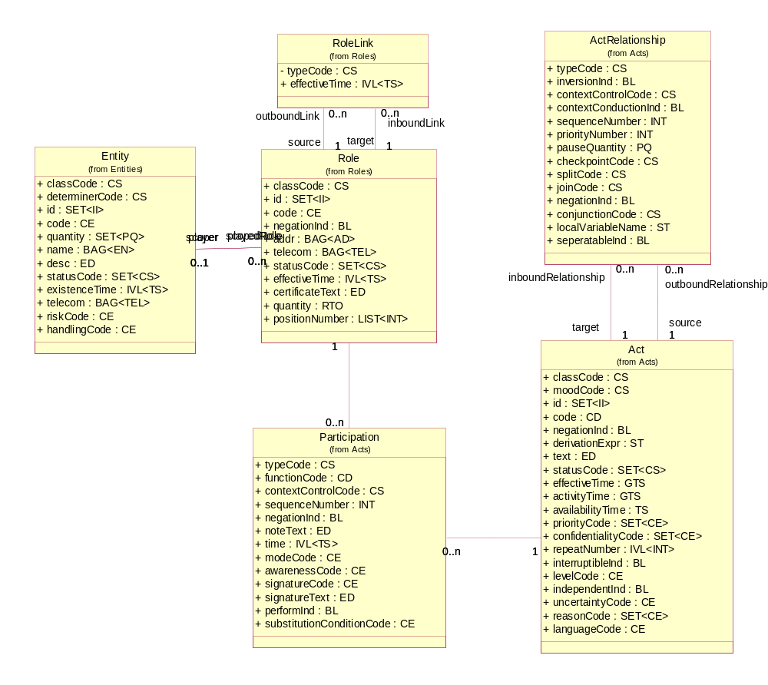
Fully Attributed HL7 RIM Core Classes

Slide 36
RIM Subject Areas
RIM classes are grouped into packages referred to as subject areas.
Some subject areas are normative and others are non-normative.
The non-normative portions of the RIM are included in the subject areas: Communication Infrastructure, Structured Documents, and Model Status
The normative portion of the RIM is composed of three subject areas: Act, Entity, and Role.
The normative subject areas includes the six core classes and the majority of their specializations

Slide 37
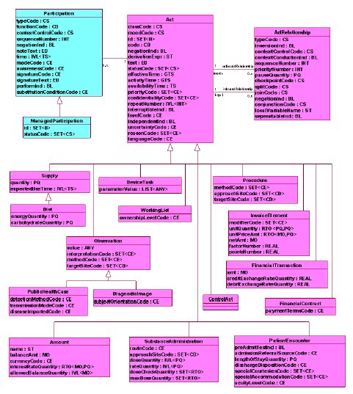
Act Subject Area

Slide 38
Act Subject Area
Act
Act Relationship
Participation
  Managed Participation
Supply
  Diet
Observation
  Public Health Case
  Diagnostic Image
Substance Administration
Patient Encounter
Procedure
Device Task
Working List
Financial Transaction
Financial Contract
Account
Invoice Element
Control Act

Slide 39
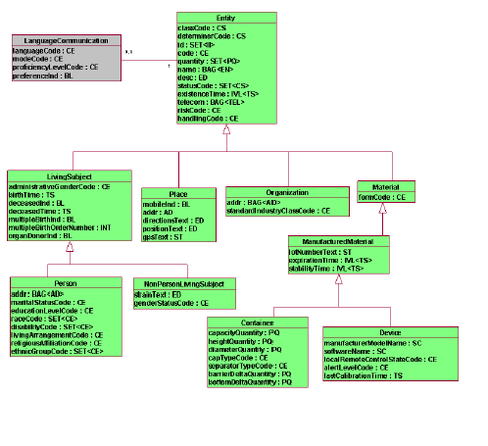
Entity Subject Area

Slide 40
Entity Subject Area
Entity
Language Communication
Living Subject
  Person
  Non-Person Living Subject
Place
Organization
Material
  Manufactured Material
    Container
    Device

Slide 41
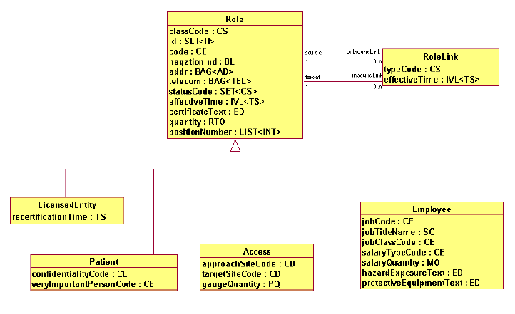
Role Subject Area

Slide 42
Role Subject Area
Role
  Licensed Entity
  Patient
  Access
  Employee
Role Link

Slide 43
Coded Structural Attributes
RIM coded attributes with a data type of Coded Simple (CS) are referred to as “structural”
A CS data type is assigned to an attribute when the only allowable code values for the attribute are determined by HL7
There are 18 such attributes in the RIM. Each of them is bound to a vocabulary value set defined by HL7.
These attributes are referred to a “structural” because their presence in the model eliminates the need to include other structural model components such as classes, generalizations, and associations.
Vocabulary value sets bound to coded structural attributes are normative.

Slide 44
Coded “Structural” Attributes
Act.classCode
Act.moodCode
Act.statusCode
ActRelationship.checkpointCode
ActRelationship.conjunctionCode
ActRelationship.joinCode
ActRelationship.splitCode
ActRelationship.Type
ActRelationship.contextControlCode
Entity.classCode
Entity.determinerCode
Entity.statusCode
ManagedParticipation.statusCode
Participation.contextControlCode
Participation.typeCode
Role.classCode
Role.statusCode
RoleLink.typeCode

Slide 45
Normative Class and Attribute Tags
The RIM is expressed using the Unified Modeling Language (UML) with HL7 specific tags as extensions to the UML model element metadata.
All standard UML model element metadata values are normative but only the following HL7 extensions are also normative:
  Class.stateAttribute
  Class.classCode
  Attribute.mandatoryInclusion
  Attribute.cardinality
  Attribute.vocabDomain
  Attribute.vocabStrength
The remaining HL7 extensions are for administrative use only and are not part of the normative RIM specification.

Slide 46
Implications of Normative
The normative portions of the RIM are the only portions subject to ballot and are the only portions for which conformance rules are defined.
Substantive changes to normative RIM model elements require a re-ballot of the RIM.
When re-balloting the RIM, only the substantive changes are subject to ballot.
The following changes to the RIM are considered non-substantive:
  Changes to descriptive text for model elements that does not materially alter the semantics of the model element;
  Changes to class package assignments other than additions or deletions from the NormativeContent subject area;
  Changes in package hierarchies or names;
  Changes to class diagram layouts;
  Changes to model elements outside the NormativeContent subject area package.

Slide 47
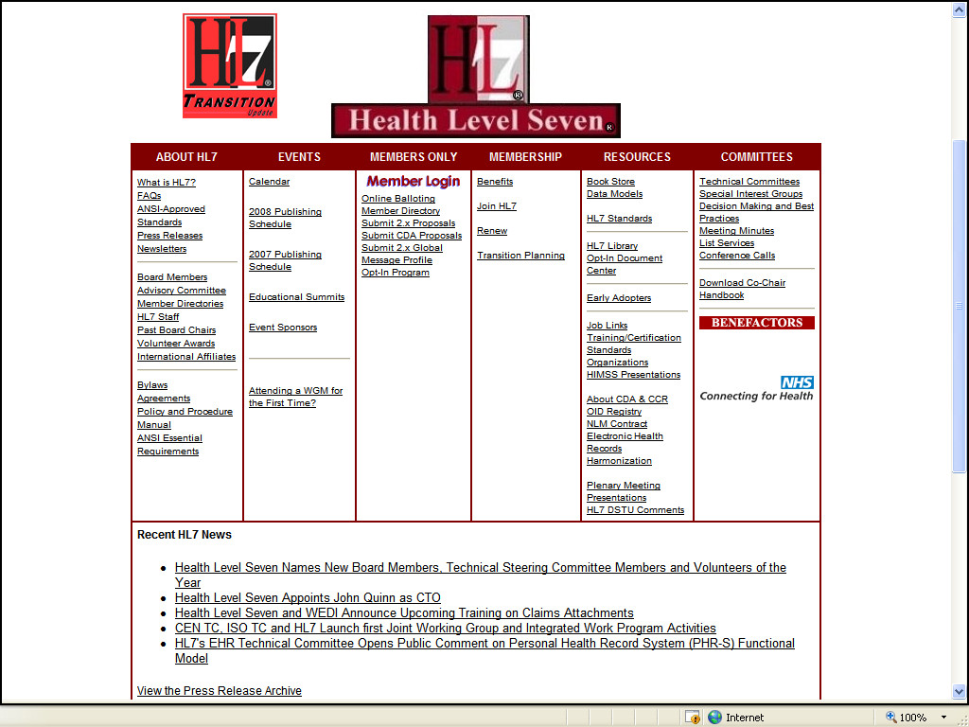
www.hl7.org

Slide 48
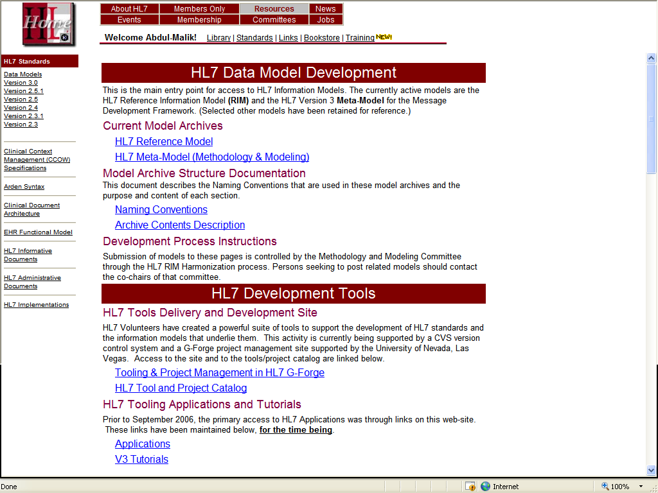
Data Models and Development Tools

Slide 49
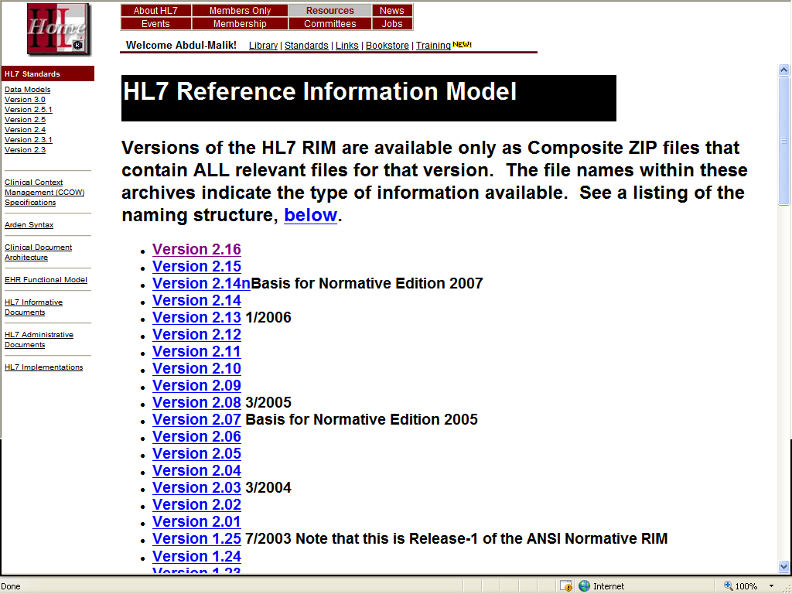
HL7 Reference Information Model

Slide 50
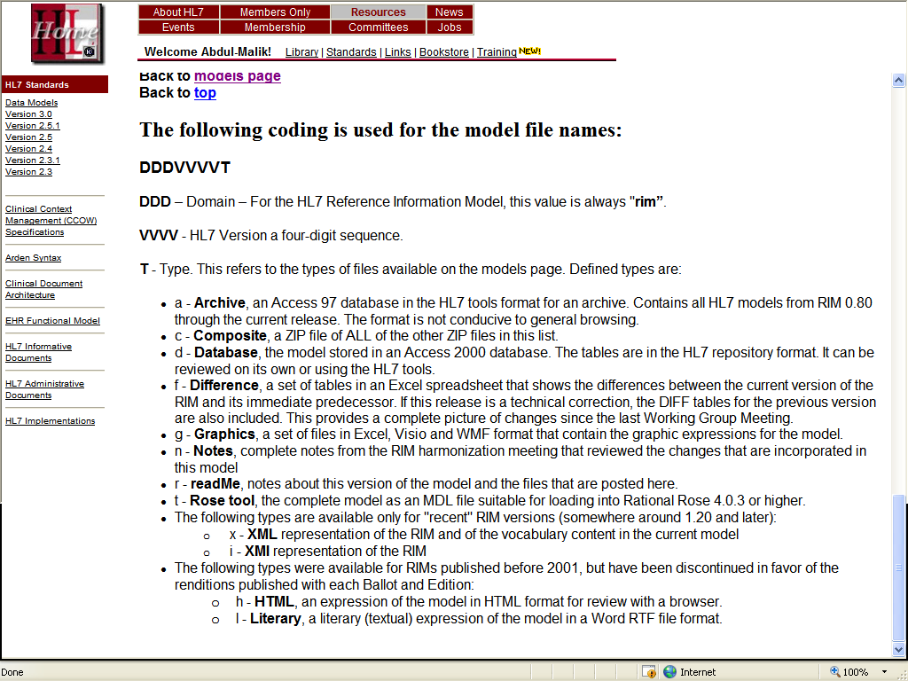
RIM Model Files

Slide 51
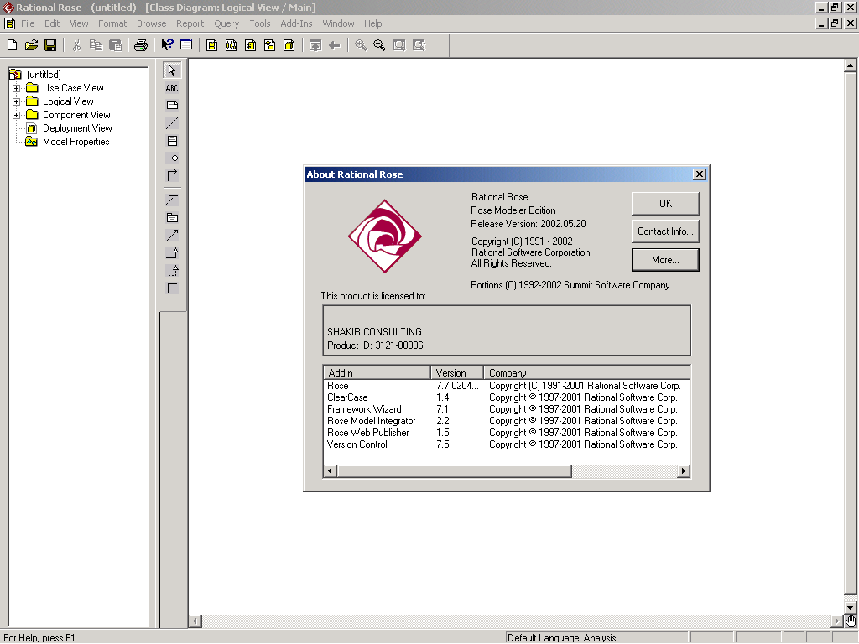
Rational Rose

Slide 52
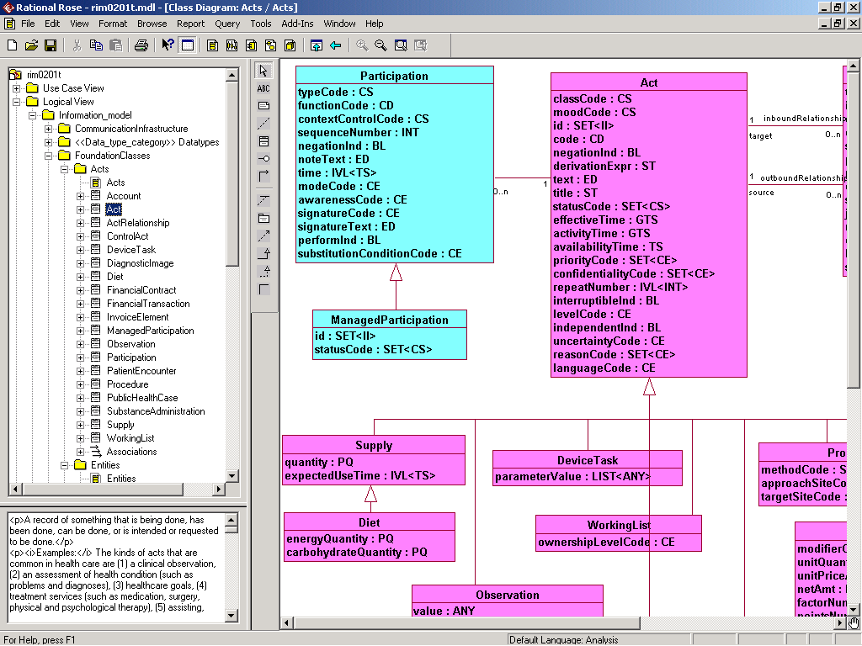
Rational Rose Class Diagram

Slide 53
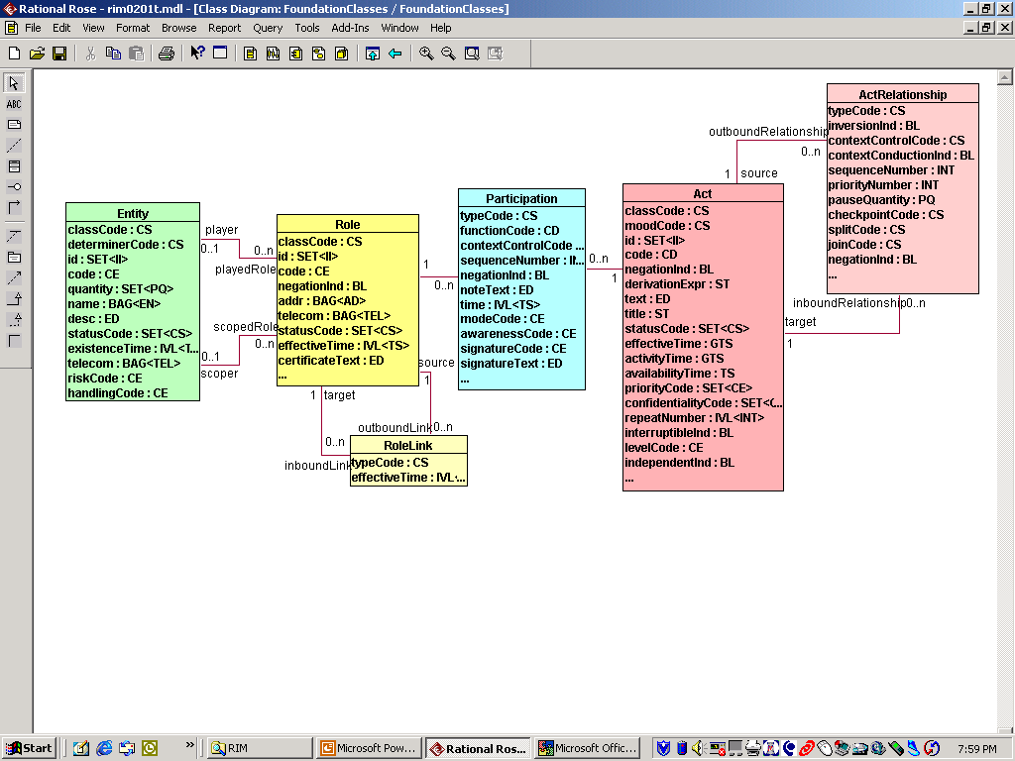
RIM Backbone Core Classes

Slide 54
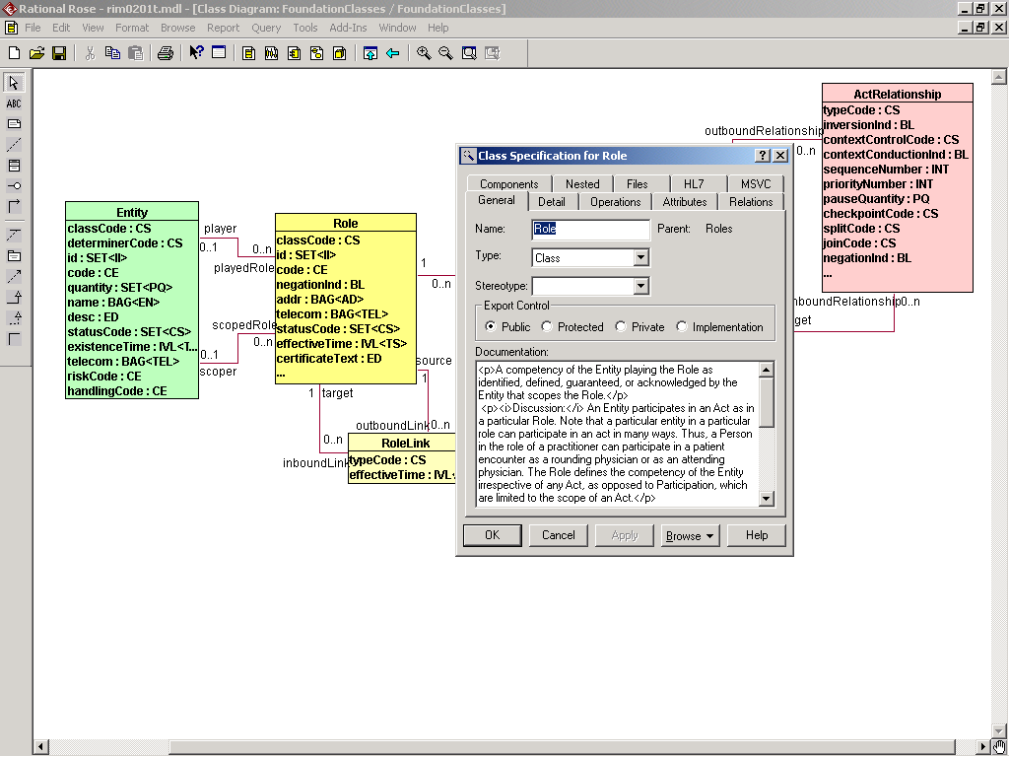
Class Properties

Slide 55
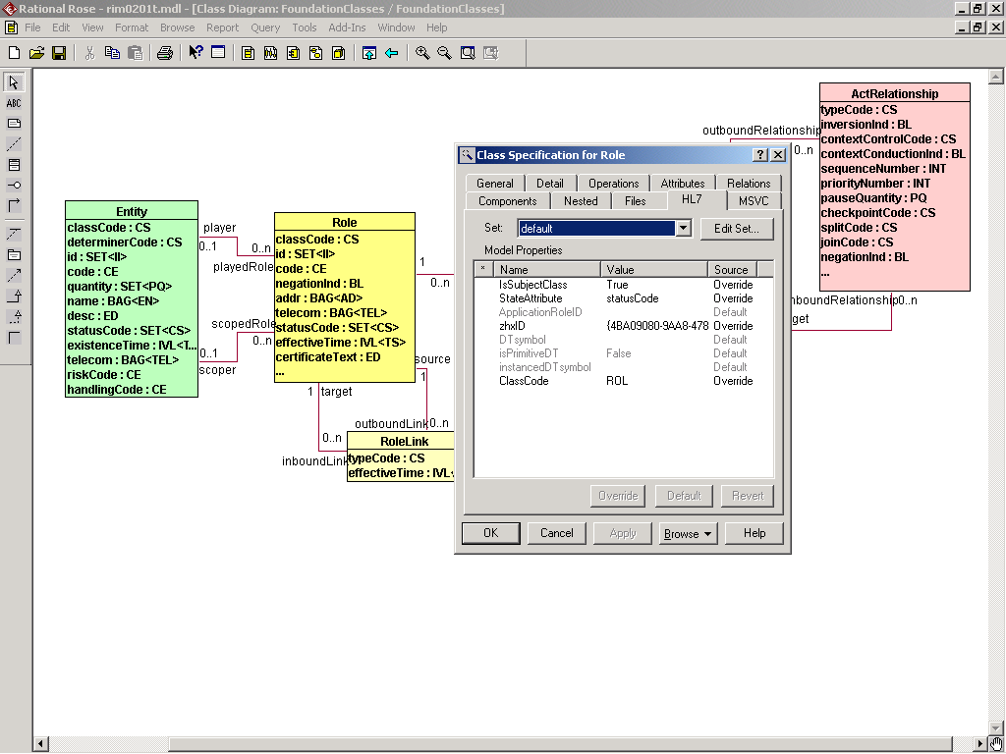
HL7 Class Properties Extensions

Slide 56
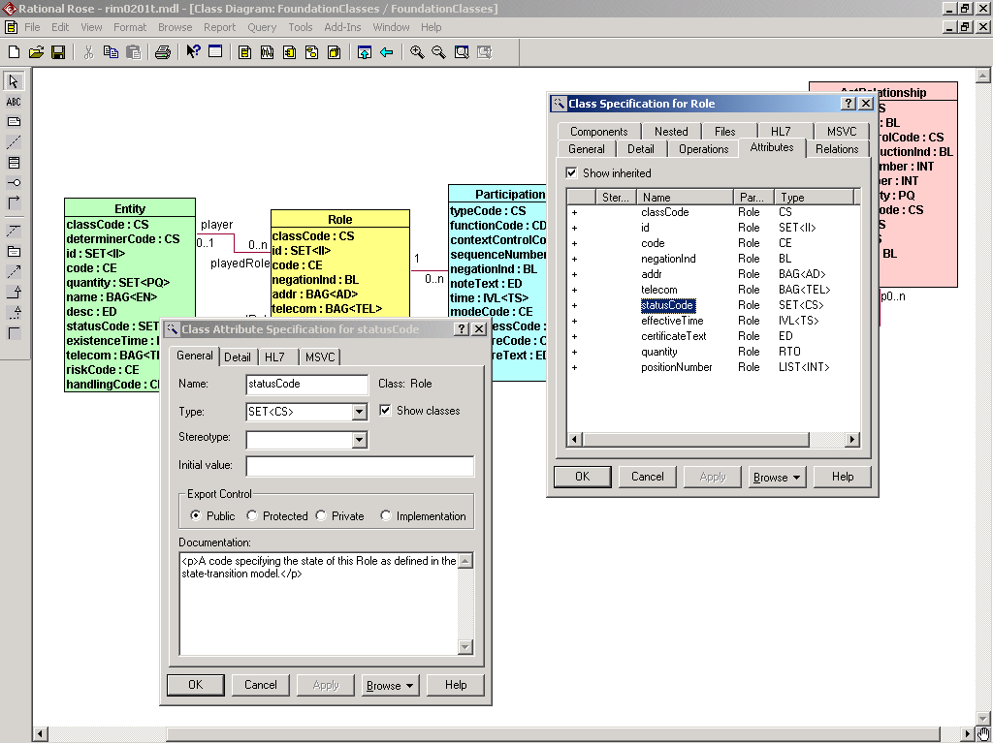
Attribute Properties

Slide 57
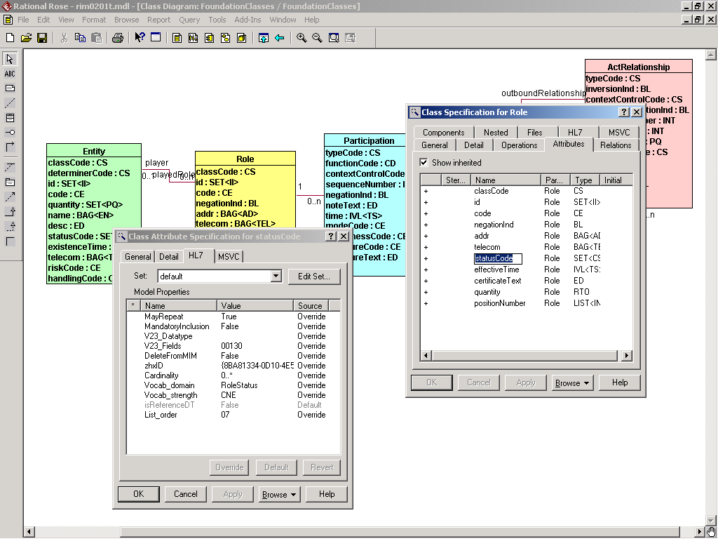
HL7 Attribute Properties Extensions

Slide 58
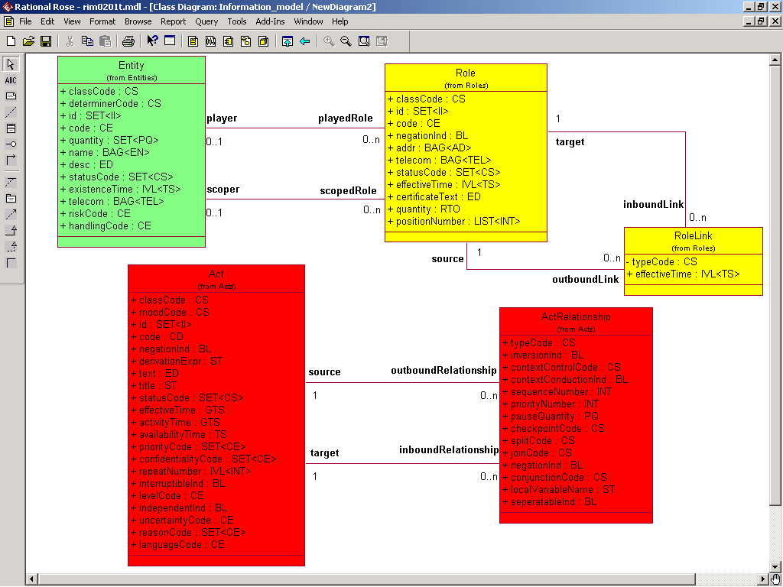
Association Role Names

Slide 59
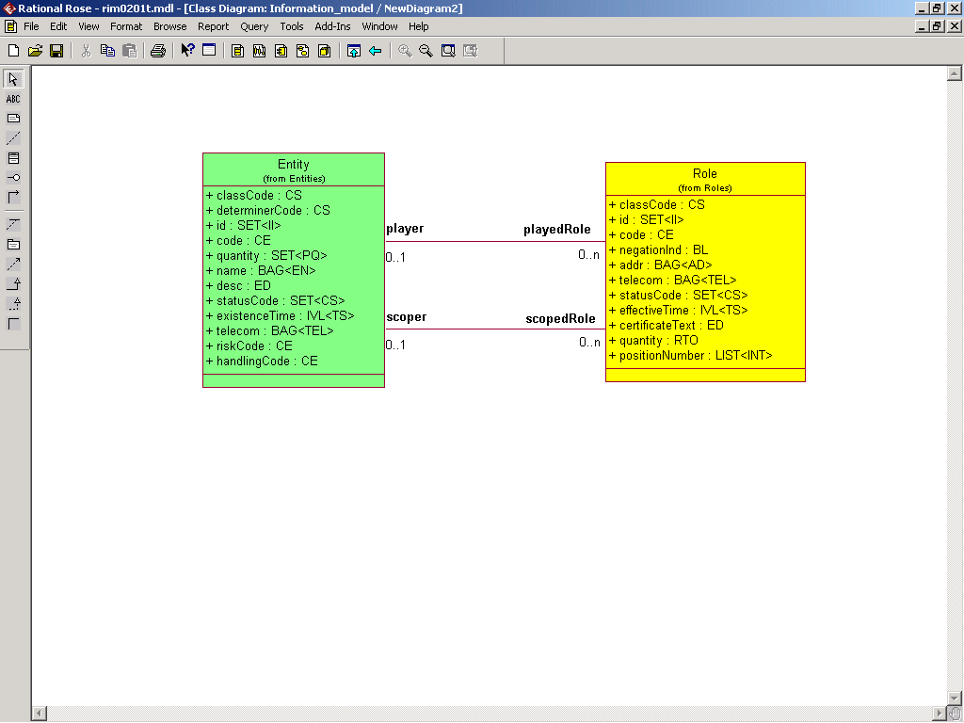
Entity/Role Associations

Slide 60
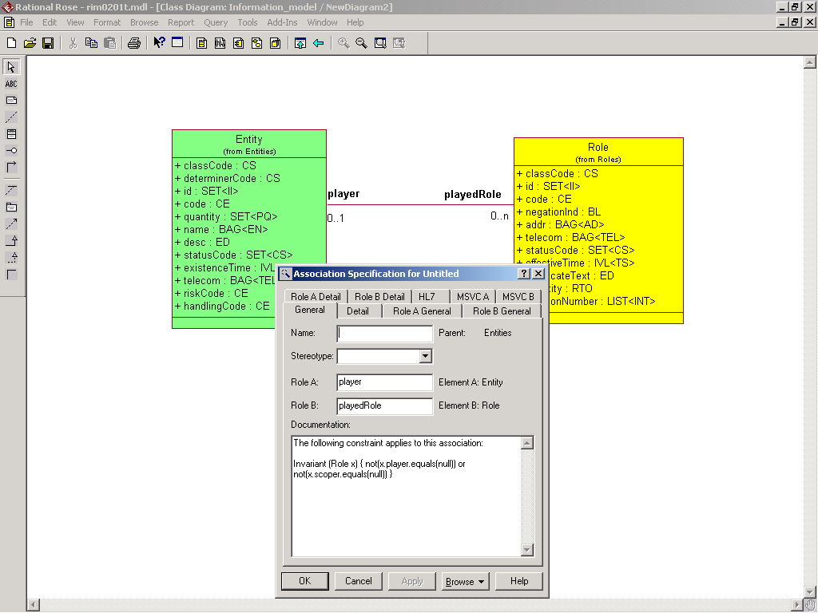
Entity/Role Association Constraint

Slide 61
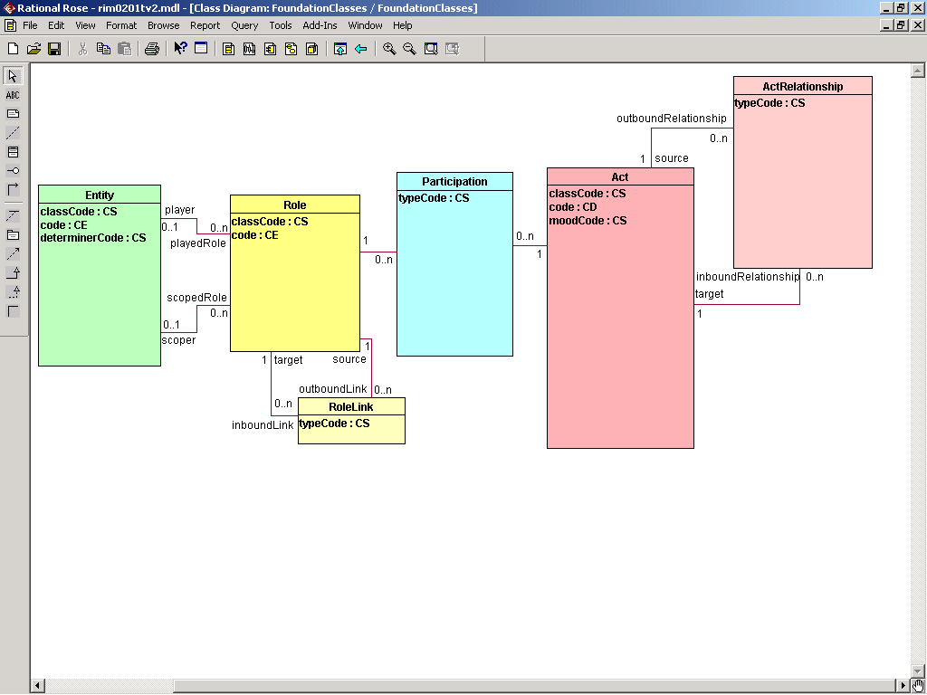
Core Attributes of Core Classes

Slide 62
Act.classCode
3.1.1.1 Act.classCode :: CS (1..1) Mandatory
Vocabulary domain: ActClass (CNE)
Attribute description:
A code specifying the major type of Act that this Act-instance represents.
Constraints:
The classCode domain is a tightly controlled vocabulary, not an external or user-defined vocabulary.
Every Act-instance must have a classCode. If the act class is not further specified, the most general Act.classCode (ACT) is used.
The Act.classCode must be a generalization of the specific Act concept (e.g., as expressed in Act.code), in other words, the Act concepts conveyed in an Act must be specializations of the Act.classCode. Especially, the classCode is not a "modifier" or the Act.code that can alter the meaning of a class code. (See Act.code for contrast.)

Slide 63
Act.moodCode
3.1.1.2 Act.moodCode :: CS (1..1) Mandatory
Vocabulary domain: ActMood (CNE)
Attribute description:
A code distinguishing whether an Act is conceived of as a factual statement or in some other manner as a command, possibility, goal, etc.
Constraints:
An Act-instance must have one and only one moodCode value. The moodCode of a single Act-instance never changes. Mood is not state. To describe the progression of a business activity from defined to planned to executed, etc. one must instantiate different Act-instances in the different moods and link them using ActRelationship of general type "sequel". (See ActRelationship.typeCode.)
Discussion:
The Act.moodCode includes the following notions: (1) event, i.e., factual description of an actions that occurred; (2) definition of possible actions and action plans (the master file layer); (3) intent, i.e., an action plan instantiated for a patient as a care plan or order; (4) goal, i.e., an desired outcome attached to patient problems and plans; and (5) criterion, i.e., a predicate used to evaluate a logical expression

Slide 64
Act.code
3.1.1.4 Act.code :: CD (0..1)
Vocabulary domain: ActCode (CWE)
Attribute description:
A code specifying the particular kind of Act that the Act-instance represents within its class.
Constraints:
The kind of Act (e.g. physical examination, serum potassium, inpatient encounter, charge financial transaction, etc.) is specified with a code from one of several, typically external, coding systems. The coding system will depend on the class of Act, such as LOINC for observations, etc. Conceptually, the Act.code must be a specialization of the Act.classCode. This is why the structure of ActClass domain should be reflected in the superstructure of the ActCode domain and then individual codes or externally referenced vocabularies subordinated under these domains that reflect the ActClass structure.

Slide 65
Core Attributes of Core Classes

Slide 66
ActRelationship.typeCode
3.1.2.1 ActRelationship.typeCode :: CS (1..1) Mandatory
Vocabulary domain: ActRelationshipType (CNE)
Attribute description:
A code specifying the meaning and purpose of every ActRelationship instance. Each of its values implies specific constraints to what kinds of Act objects can be related and in which way.
Discussion:
The types of act relationships fall under one of 5 categories:
1.) (De)-composition, with composite (source) and component (target).
2.) Sequel which includes follow-up, fulfillment, instantiation, replacement, transformation, etc. that all have in common that source and target are Acts of essentially the same kind but with variances in mood and other attributes, and where the target exists before the source and the source refers to the target that it links back to.
3.) Pre-condition, trigger, reason, contraindication, with the conditioned Act at the source and the condition or reason at the target.
4.) Post-condition, outcome, goal and risk, with the Act at the source having the outcome or goal at the target.
5.) A host of functional relationships including support, cause, derivation, etc. generalized under the notion of "pertinence".

Slide 67
Core Attributes of Core Classes

Slide 68
Participation.typeCode
3.1.3.1 Participation.typeCode :: CS (1..1) Mandatory
Vocabulary domain: ParticipationType (CNE)
Attribute description:
A code specifying the kind of Participation or involvement the Entity playing the Role associated with the Participation has with regard to the associated Act.
Constraints:
The Participant.typeCode contains only categories that have crisp semantic relevance in the scope of HL7. It is a coded attribute without exceptions and no alternative coding systems allowed.

Slide 69
Core Attributes of Core Classes

Slide 70
Entity.classCode
3.2.1.1 Entity.classCode :: CS (1..1) Mandatory
Vocabulary domain: EntityClass (CNE)
Attribute description:
An HL7 defined value representing the class or category that the Entity instance represents.
Examples:
Person, Animal, Chemical Substance, Group, Organization
Rationale:
Due to the extremely large number of potential values for a code set representing all physical things in the universe, the class code indicates both the subtype branch of the Entity hierarchy used as well as a high level classifier to represent the instance of Entity. This can be used to constrain the eligible value domains for the Entity.code attribute.

Slide 71
Entity.determinerCode
3.2.1.2 Entity.determinerCode :: CS (1..1) Mandatory
Vocabulary domain: EntityDeterminer (CNE)
Attribute description:
An HL7 defined value representing whether the Entity represents a kind-of or a specific instance.
Examples:
1 human being (an instance), 3 syringes (quantified kind) or the population of Indianapolis (kind of group)
Rationale:
An Entity may at times represent information concerning a specific instance (the most common), a quantifiable group with common characteristics or a general type of Entity. This code distinguishes these different representations.

Slide 72
Entity.code
3.2.1.4 Entity.code :: CE (0..1)
Vocabulary domain: EntityCode (CWE)
Attribute description:
A value representing the specific kind of Entity the instance represents.
Examples:
A medical building, a Doberman Pinscher, a blood collection tube, a tissue biopsy.
Rationale:
For each Entity, the value for this attribute is drawn from one of several coding systems depending on the Entity.classCode, such as living subjects (animal and plant taxonomies), chemical substance (e.g., IUPAC code), organizations, insurance company, government agency, hospital, park, lake, syringe, etc. It is possible that Entity.code may be so fine grained that it represents a single instance. An example is the CDC vaccine manufacturer code, modeled as a concept vocabulary, when in fact each concept refers to a single instance.

Slide 73
Core Attributes of Core Classes

Slide 74
Role.classCode
3.3.1.1 Role.classCode :: CS (1..1) Mandatory
Vocabulary domain: RoleClass (CNE)
Attribute description:
A code specifying the major category of a Role as defined by HL7 vocabulary.

Slide 75
Role.code
3.3.1.3 Role.code :: CE (0..1)
Vocabulary domain: RoleCode (CWE)
Attribute description:
A code further specifying the kind of Role.
Discussion:
The Role.code must conceptually be a proper specialization of Role.classCode. Role.code does not modify Role.classCode. Rather, each is a complete concept or a Role-like relationship between two Entities, but Role.code may be more specific than Role.classCode.
The Role.code may not be coded if only an un-coded name for the type of role is commonly used.

Slide 76
Core Attributes of Core Classes

Slide 77
RoleLink.typeCode
3.3.2.1 RoleLink.typeCode :: CS (1..1) Mandatory
Vocabulary domain: RoleLinkType (CNE)
Attribute description:
A code specifying the kind of connection represented by this RoleLink, e.g., has-part, has-authority.

Slide 78
Core Attributes of Core Classes

Slide 79
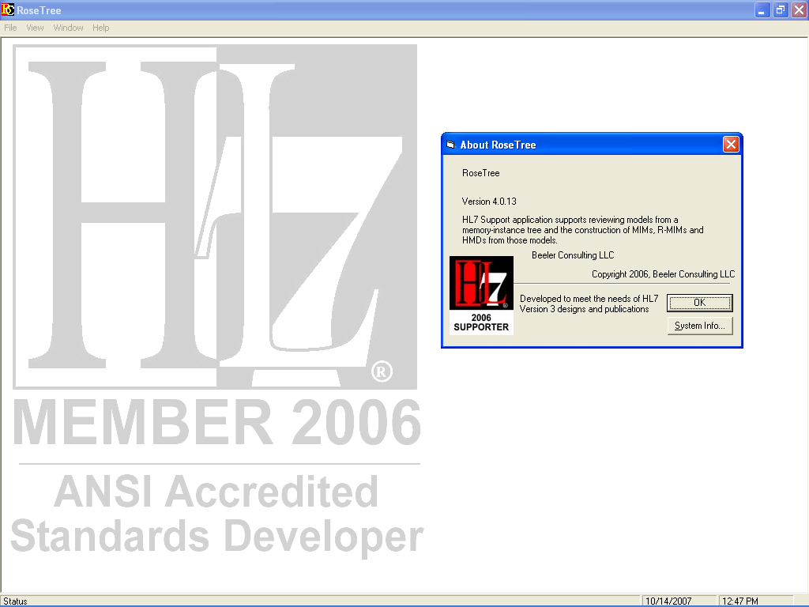
RoseTree

Slide 80
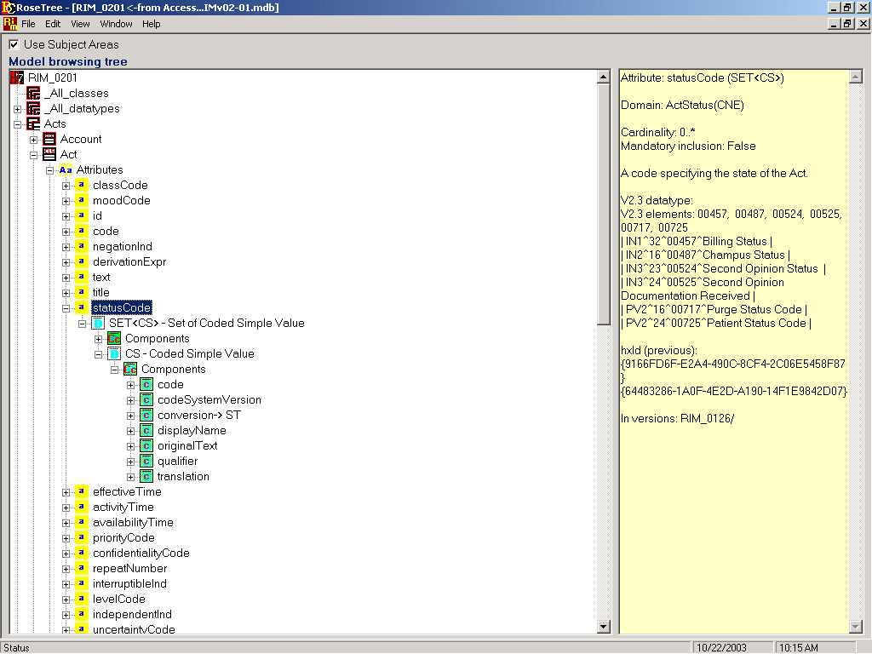
Model Browsing Tree - Attributes
Packages (AKA Subject Areas)
Classes
Attributes
Datatype
Datatype Components
(AKA Properties)
Descriptive
Text

Slide 81
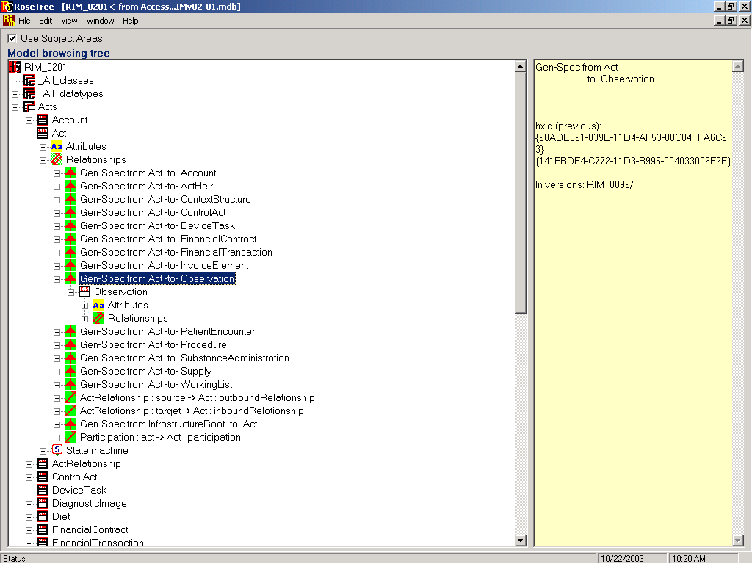
Model Browsing Tree - Relationships
Source Class (AKA Focal Class)
Relationships
Distal Class
Descriptive
Text

Slide 82
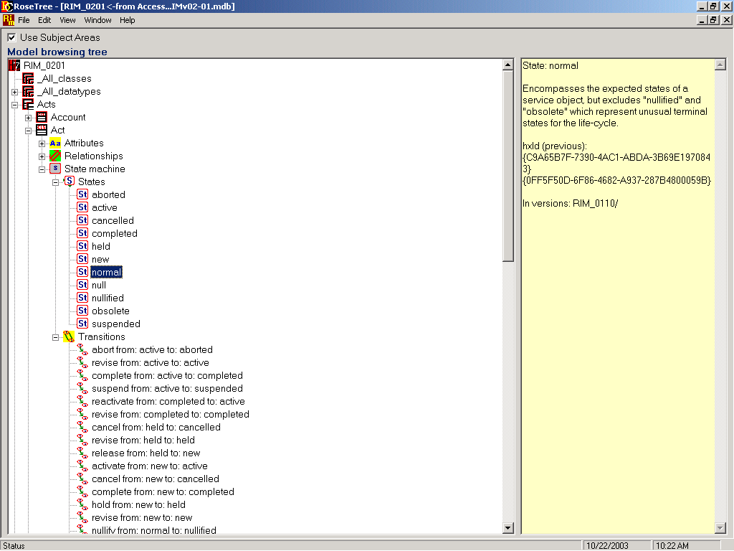
Model Browsing Tree - States
States
Transitions
Descriptive
Text

Slide 83

State Machine
The HL7 Reference Information Model includes state machines for the Entity, Role, ManagedParticipation, and Act classes.
A state machine specifies the allowable states and valid state transitions for a given class.
When a class transitions from one state to another sometimes triggers an interactions.

Slide 84
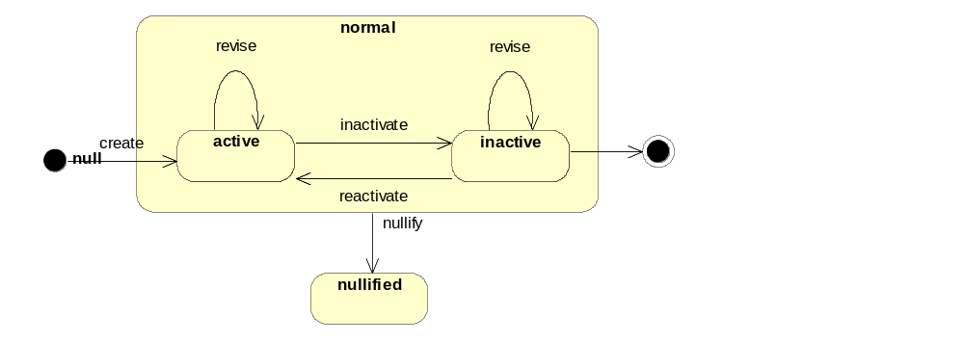
Entity State Machine

Slide 85
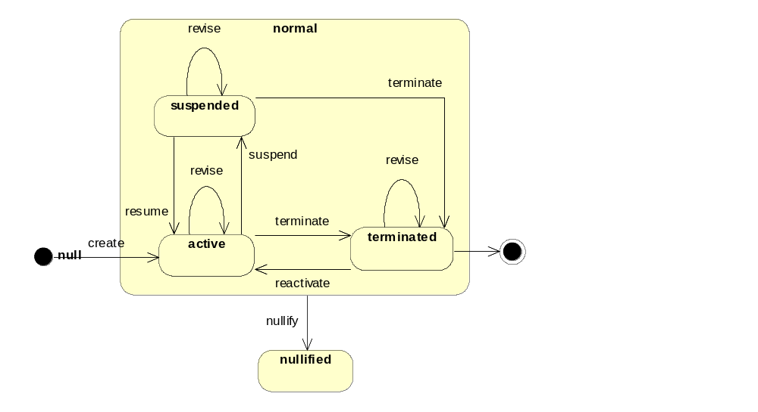
Role State Machine

Slide 86
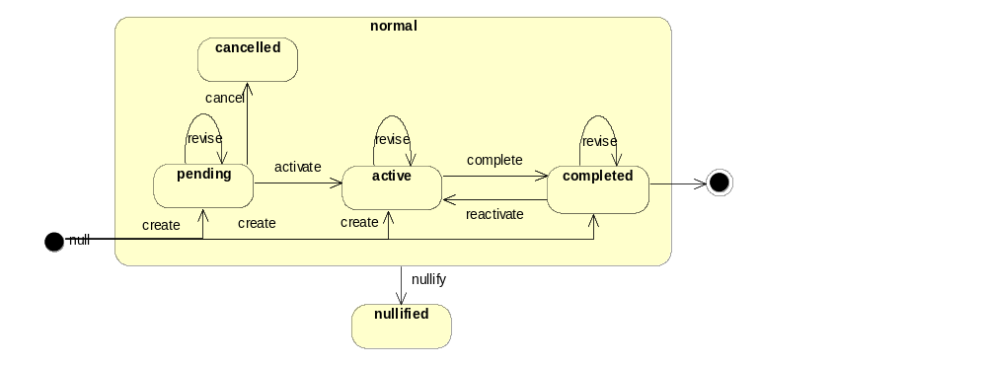
Managed Participation State Machine

Slide 87
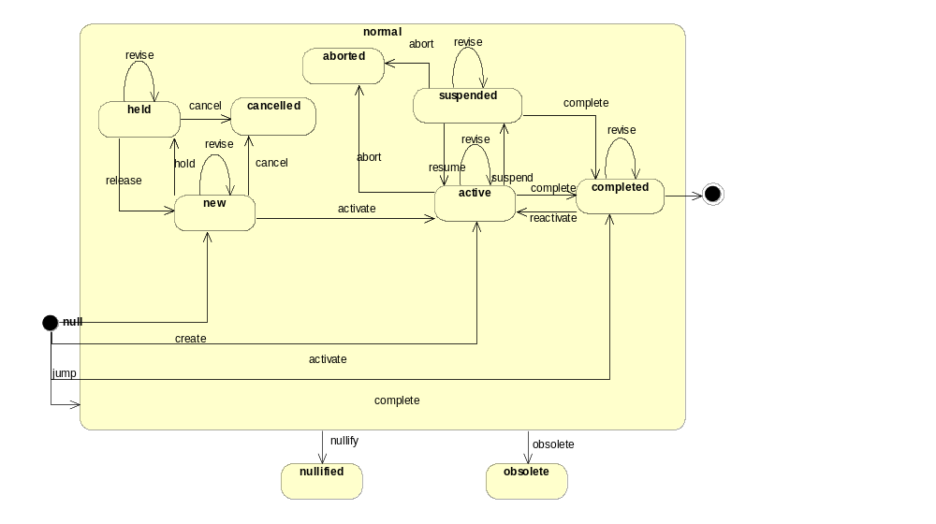
Act State Machine

Slide 88
Model Browsing Tree - States
States
Transitions
Descriptive
Text

Slide 89
HL7 Version 3.0
Data Type Specification
The HL7 Datatype Specification defines the structural format of the data carried in an attribute and influences the set of allowable values an attribute may assume.

Slide 90
HL7 Version 3.0 Data Types
HL7 data types define the structure and constrain the allowable values of attributes in the RIM.
The HL7 data type specification declares the set of data types, identifies components of complex types, and defines relationships between data types.
The HL7 data type implementation technology specification defines constraints and operations for data types and describes how data types are to be represented in XML.
Data types are reusable atomic building blocks used to create all HL7 V3 information structures.
Each RIM attribute is assigned one data type; each data type is assigned to zero, one, or more RIM attribute.

Slide 91
HL7 Version 3.0 Data Types
AD: Postal Address
ANY: DataValue
BAG: Bag
BL: Boolean
CD: Concept Descriptor
CE: Coded With Equivalents
CS: Coded Simple Value
ED: Encapsulated Data
EN: Entity Name
GTS: General Timing Specification
HIST: History
II: Instance Identifier
INT: Integer Number
IVL: Interval
LIST: Sequence
MO: Monetary Amount
ON: Organization Name
PN: Person Name
PPD: Parametric Probability Distribution
PQ: Physical Quantity
REAL: Real Number
RTO: Ratio
SC: Character String with Code
SET: Set
ST: Character String
TEL: Telecommunication Address
TN: Trivial Name
TS: Point in Time
UVP: Uncertain Value - Probabilistic

Slide 92
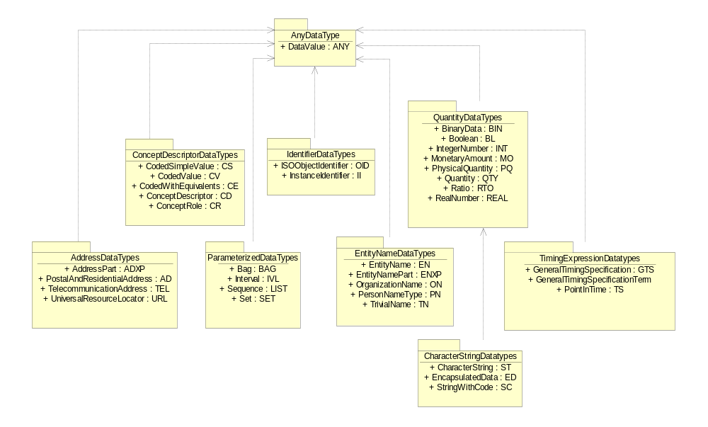
HL7 Data Type Packages

Slide 93
Attribute Naming Convention
[Class Name]-{Qualifier Word}-Attribute Type :: Datatype
Where:
  Class Name is the name of the class the attribute is located in.
  Class name may be omitted but remains an assumed part of the
  Attribute name for the purpose of determining uniqueness.
  Qualifier Word is a word used to convey the business meaning of the attribute and to disambiguate the attribute from others of the same type in the class.
  Attribute Type indicates the classification of the attribute as specified in a previously specified, collection of attribute type names.
  Datatype specifies attribute components, structure, and allowable values.

Slide 94
Example Attribute Name Parts
Act
Class Name
  ACT
Qualifier Words
  Class
  Mood
  Status
  Effective
Attribute Types
  CD
  Time
  ID
Datatypes
  CD
  CS
  GTS
  II
class_cd : CS
cd: CD
mood_cd : CS
status_cd : CS
effective_time : GTS
id : II

Slide 95
Attribute Type Definitions and Suggested Datatypes
Short Name | Full Name | Usage Notes | Suggested Data Types
ADDR | Address | For attributes representing the location at which an organization, person, or item may be found or reached. | AD
CD | Code | For attributes representing some concept. Note that names of individual things are not considered concepts. | CV, CD
COM | Communication address | For attributes representing communication addresses, such as telephones, fax, pagers, e-mail, Web-sites and other devices and their respective protocols. See also PHON. | TEL
DESC | Description | For attributes representing a statement used to describe something. | ED
DTTM | Date and Time | For attributes representing a point in time at which an event happened or will happen. Levels of precision and variation are part of this concept and should usually not be specified in separate attributes. | TS
EXPR | Formal expression | For attributes representing formalized text that is to be evaluated primarily by computes. An attribute named “constraint_txt” is most likely such a formal expression and should be renamed to “constraint_expr”. | ST

Slide 96
Attribute Type Definitions and Suggested Datatypes
Short Name | Full Name | Usage Notes | Suggested Data Types
FRC | Fraction | For attributes that represent a fraction or proportion. The former attribute type PCT for “percentage” is superceded by FRC and is no longer permitted. See also QTY. | REAL
ID | Identifier | For attributes that serve to identify some instance of an information model class. Note that real world Identifiers (e.g., SSN) exist not as attributes but as an association to a special information model class. The attribute type “id” without a prefix is reserved to be the main instance identifier of the class. | II
IND | Indicator | For attributes representing a specific condition as true or false. | BL
NBR | Number | For attributes representing dimensionless numbers. Note that there is a big conceptual difference between integer numbers and floating point numbers. See also QTY. | INT, REAL
NM | Name | For attributes that represent a name by which an instance of the class is known. | ST, PN, ON
PHON | Phone | For attributes representing telephone number of a telecommunication device. See also COM. | TEL

Slide 97
Attribute Type Definitions and Suggested Datatypes
Short Name | Full Name | Usage Notes | Suggested Data Types
QTY | Quantity | For attributes representing a quantity. The nature of the quantity must be further specified through the choice of data type and through additional constraints. For physical quantities (including elapsed time) the PQ data type must be used. For monetary amounts the MO data type must be used. Parallel unit attributes are not permitted in these cases. Counted objects are not physical quantities and the count nouns are not units of measure. | PQ, MO, REAL, INT, RTO
TMR | Time Range | A range of time between a start and an end time having a duration. The range may be infinite or undefined on either side. | IVL⟨PT⟩
TIME | General Timing | A range of time between a start and an end time having a duration. The range may be infinite or undefined on either side. | GTS
TXT | Text | For attributes representing non-descriptive, non-naming text not targeted to human interpretation. Formal expressions evaluated by computers should use the EXPR attribute type instead. | ED
VALUE | Value | For an attribute (e.g., Observation.value) that represents a value whose data type is determined dynamically and is not predefined by the static class diagram. | ANY

Slide 98
Attribute types and Datatypes
Attribute types
  Provide a general characterization of an attribute
  Are defined in information model section of MDF
  Control the naming of attributes
  Indicate the set of applicable data types
  Must be assigned when an attribute is defined
Datatypes
  Are specifications for the value domain of an attribute
  Are balloted formally by HL7
  Once assigned to an attribute, may not be changed
  May be defined as late as when the attribute is used in an HMD

Slide 99
Datatypes are analogous to Classes
Class
Classes have attributes
Each attribute is assigned a data type
Classes have hierarchies
Classes have explicit associations
Datatype
Some Data types have components
Each component is assigned a data type
Data types have hierarchies
Data types have implicit associations

Slide 100
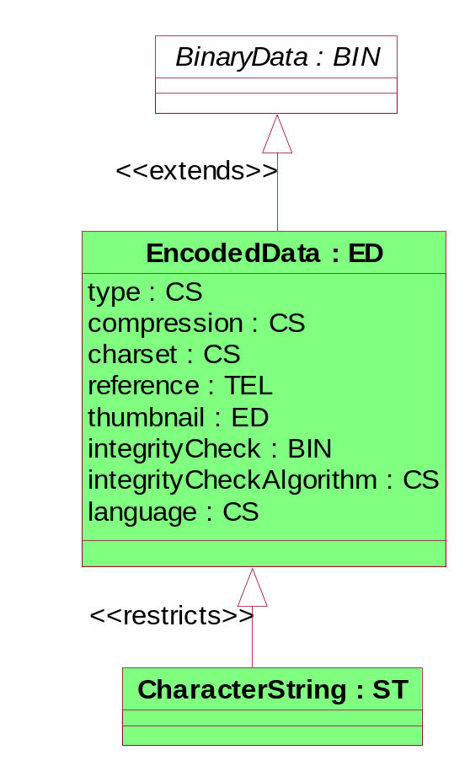
Datatype Representation
Datatypes are represented using notation similar to the notation for classes.
The datatype name is followed by its short name.
The datatype components are listed similar to attributes but do not follow the RIM attribute naming convention.
Generalization hierarchies for datatypes are annotated with the phrase “extends” or “restricts”
  “Extends” indicates that the datatype inherits from its parent datatype and adds to its specifications
  “Restricts” indicates that the datatype inherits from its parent datatype and reduces its specification

Slide 101
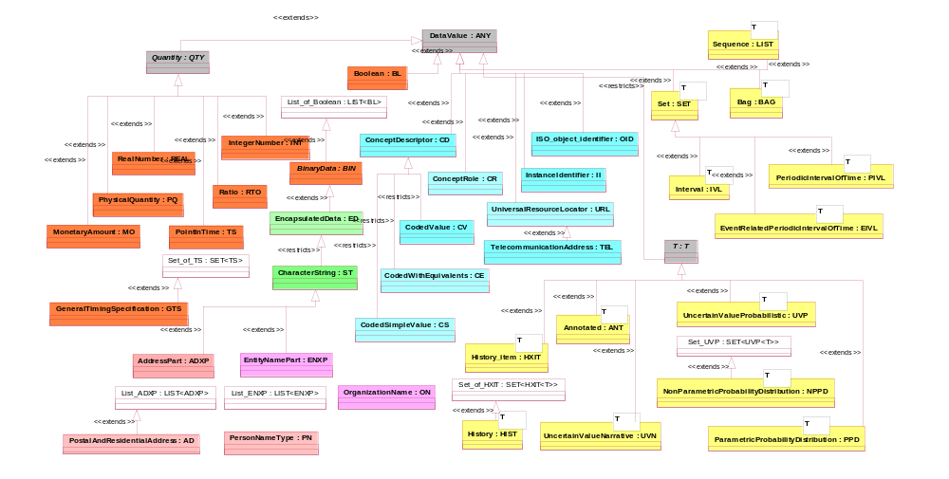
Datatype Class Diagram

Slide 102
Datatype Subject Areas
Text
Demographic
Descriptor
Quantity
Time
Generic

Slide 103
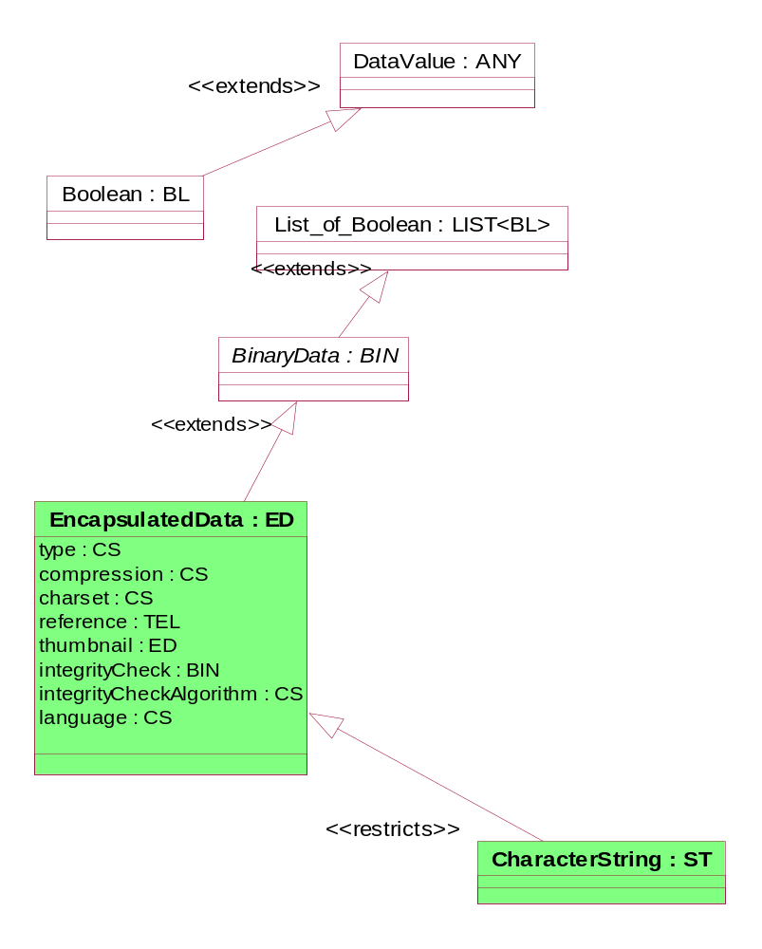
Text Datatypes

Slide 104
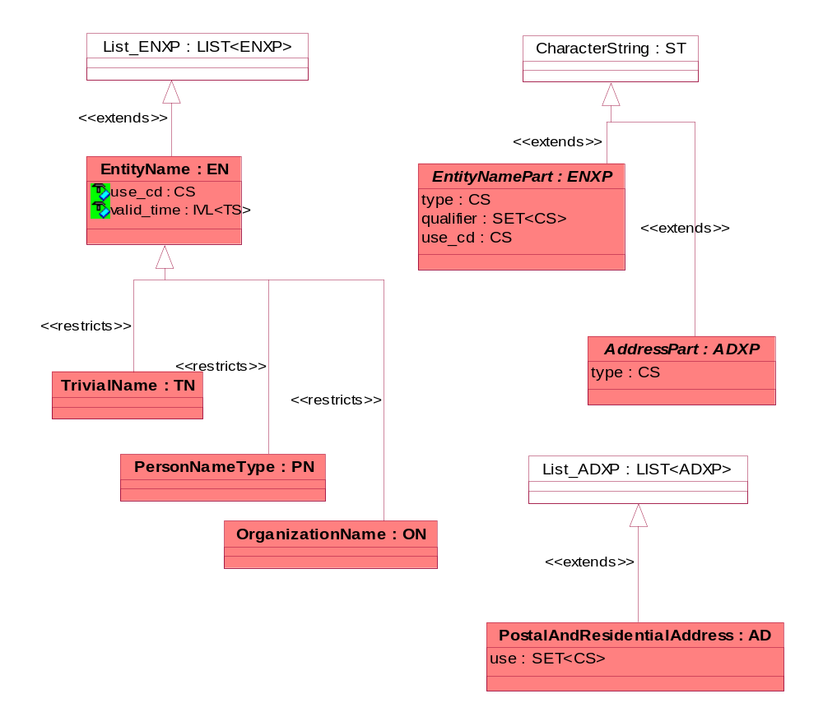
Demographic Datatypes

Slide 105
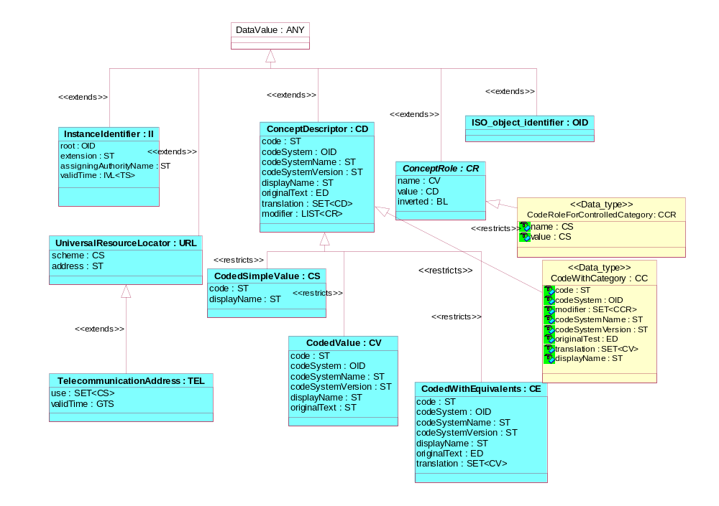
Descriptor Datatypes

Slide 106
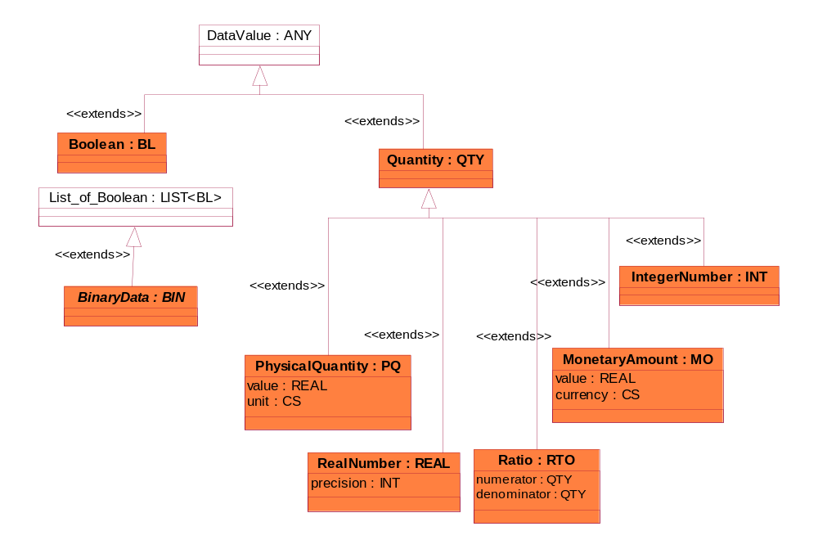
Quantity Datatypes

Slide 107
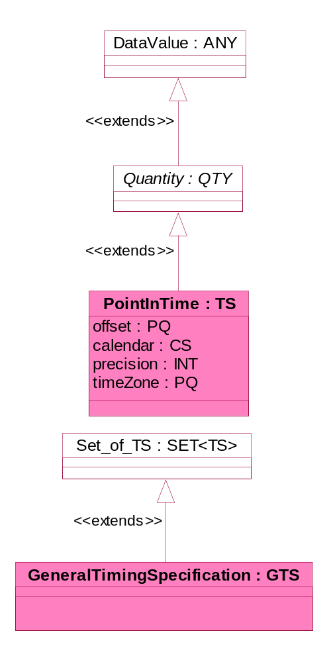
Time Datatype

Slide 108
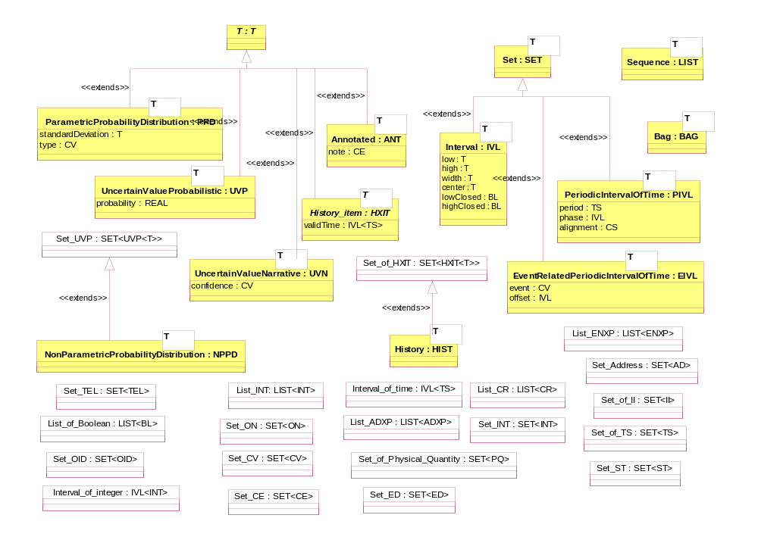
Generic Datatypes

Slide 109
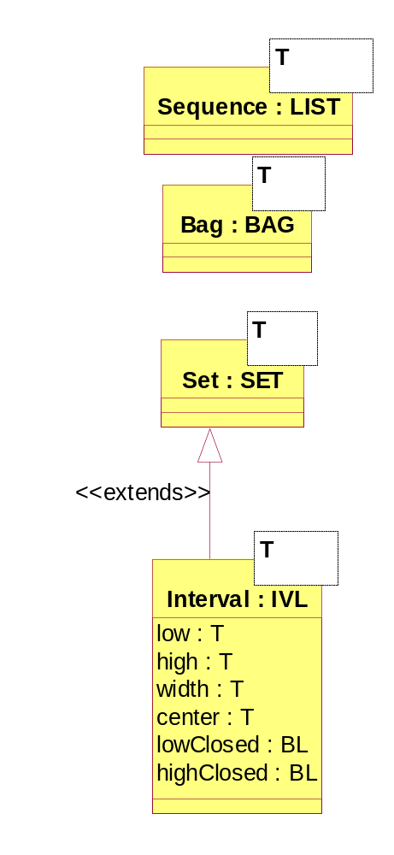
Generic data types
Provide a means for applying an operation (such as an interval or a probability distribution) to values expressed in another data type.
Examples:
  interval - of time, of values, etc.
  list - of addresses, of person name parts
  set - of codes
List - an ordered collection of items
Bag - an unordered collection of items
Set - an unordered collection of unique items
Interval - applies to any ordered type

Slide 110
DataValue: The Root of All Datatypes
Datatypes are assigned to attributes and characterize the data values of the attribute.
A data value can be of any HL7 defined datatype.
Data values have two properties in addition to the value itself.
  DataType that declares which HL7 datatype is applicable to the data value
  NullFlavor that provides a reason for missing or null values.
DataValue : ANY
dataType : CS
nullFlavor : CS

Slide 111
Flavors of Null
Concept | Symbol | Implies | Definition
no information | NI |  | No information whatsoever can be inferred. This is the default null flavor.
not applicable | NA | NI | No proper value is applicable in this context (e.g., last menstrual period for a male.)
unknown | UNK | NI | A proper value is applicable, but not known.
not asked | NASK | UNK | This information has not been sought (e.g., patient was not asked)
asked but unknown | ASKU | UNK | Information was sought but not found (e.g., patient was asked but didn't know)
temporarily unavailable | NAV | ASKU | Information is not available at this time but it is expected that it will be available later.
other | OTH |  | The actual value is not an element in the value domain of a variable. (e.g., diagnoses is not in ICD-9 code set; age exceeds 100-year upper limit restriction for this field.)
positive infinity | PINF | OTH | Positive infinity of numbers.
negative infinity | NINF | OTH | Negative infinity of numbers.
not present | NP |  | Value is not present in a message. This is only defined in messages, never in application data! If a value is not present in a message the receiving interface must fill in that value with either an applicable default, or no-information (NI).

Slide 112
v3.0 Ballot Datatype Categories
Basic Datatypes
  Boolean (BL) Character String (ST)
  Concept Descriptor (CD) Encapsulated Data (ED)
  Entity Name (EN) Instance Identifier (II)
  Integer Number (INT) Monetary Amount (MO)
  Physical Quantity (PQ) Point In Time (TS)
  Postal Address (AD) Ratio (RTO)
  Real Number (REAL) Telecommunication Address (TEL)
Generic Collections
  Bag (BAG) Interval (IVL)
  Set (SET) Sequence (LIST)
Generic Type Extensions
  History Item (HXIT)
  History (HIST)
  Uncertain Value - Narrative (UVN)
  Uncertain Value - Probabilistic (UVP)
  Non-Parametric Probability Distribution (NPPD)
  Parametric Probability Distribution (PPD)
Timing Specifications
  Periodic Interval of Time (PIVL)
  Event-Related Periodic Interval of Time (EIVL)
  General Timing Specification (GTS)
GTS
SET
HIST
BL
ST
ED

Slide 113
Basic Datatype Descriptions
Name | Symbol | Description
Boolean | BL | The Boolean type stands for the values of two-valued logic. A Boolean value can be either true or false.
Encapsulated Data | ED | Data that is primarily intended for human interpretation or for further machine processing outside the scope of this specification. This includes unformatted or formatted written language, multimedia data, or structured information in as defined by a different standard (e.g., XML-signatures.) Instead of the data itself, an ED may contain only a reference (see TEL.) Note that the ST data type is a specialization of the ED data type when the ED media type is text/plain.
Character String | ST | Text data, primarily intended for machine processing (e.g., sorting, querying, indexing, etc.) Used for names, symbols, and formal expressions.) Note that the ST data type is a specialization of the ED data type when the ED media type is text/plain.
Coded Simple Value | CS | Coded data, consists of a code and display name. The code system and code system version is fixed by the context in which the CS value occurs. CS is used for coded attributes that have a single HL7-defined value set.
Coded Value | CV | Coded data, consists of a code, display name, code system, and original text. Used when a single code value must be sent.
Coded With Equivalents | CE | Coded data, consists of a coded value (CV) and, optionally, coded value(s) from other coding systems that identify the same concept. Used when alternative codes may exist.
Concept Descriptor | CD | Coded data, is like a CE with the extension of modifiers. Modifiers for codes have an optional role name and a value. Modifiers allow one to express, e.g., "FOOT, LEFT" as a postcoordinated term built from the primary code "FOOT" and the modifier "LEFT".

Slide 114
Basic Datatype Descriptions
Name | Symbol | Description
Instance Identifier | II | An identifier to uniquely identify an individual instance. Examples are medical record number, order number, service catalog item number, etc. Based on the ISO Object Identifier (OID)
Telecommunication Address | TEL | A telephone number or e-mail address specified as a URL. In addition, this type contains a time specification when that address is to be used, plus a code describing the kind of situations and requirements that would suggest that address to be used (e.g., work, home, pager, answering machine, etc.)
Postal Address | AD | For example, a mailing address. Typically includes street or post office Box, city, postal code, country, etc.
Entity Name | EN | A name of a person, organization, place, or thing. Can be a simple character string or may consist of several name parts that can be classified as given name, family name, nickname, suffix, etc.
Person Name | PN | A name of a person. Person names usually consist of several name parts that can be classified as given, family, nickname etc. PN is a restriction of EN.
Organization Name | ON | A name of an organization. ON name parts are typically not distinguished, but may distinguish the suffix for the legal standing of an organization (e.g. "Inc.", "Co.", "B.V.", "GmbH", etc.) from the name itself. ON is a restriction of EN.
Trivial Name | TN | A restriction of EN that is equivalent with a plain character string (ST). Typically used for the names of things, where name parts are not distinguished.
Integer Number | INT | Positive and negative whole numbers typically the results of counting and enumerating. The standard imposes no bounds on the size of integer numbers.

Slide 115
Basic Datatype Descriptions
Name | Symbol | Description
Decimal number | REAL | Fractional numbers. Typically used whenever quantities are measured, estimated, or computed from other real numbers. The typical representation is decimal, where the number of significant decimal digits is known as the precision.
Physical Quantity | PQ | A dimensioned quantity expressing the result of measurement. It consists of a real number value and a physical unit. Physical quantities are often constrained to a certain dimension by specifying a unit representing the dimension (e.g. m, kg, s, kcal/d, etc.) However, physical quantities should not be constrained to any particular unit (e.g., should not be constrained to centimeter instead of meter or inch.)
Monetary Amount | MO | The amount of money in some currency. Consists of a value and a currency denomination (e.g., U.S.$, Pound sterling, Euro, Indian Rupee.)
Ratio | RTO | A quantity explicitly including both a numerator and a denominator (e.g. 1:128.) Only in the rare cases when the numerator and denominator must stand separate should the Ratio data type should be used. Normally, the REAL, PQ, or MO data types are more appropriate.
Point in Time | TS | A time stamp.
General Timing Specification | GTS | One or more time intervals used to specify the timing of events. Every event spans one time interval (occurrence interval). A repeating event is timed through a sequence of such occurrence intervals. Such timings are often specified not directly as a sequence of intervals but as a rule, e.g., "every other day (Mon - Fri) between 08:00 and 17:00 for 10 minutes."

Slide 116
ED: Encapsulated Data
Name | Type | Status | Definition
BIN | BIN | mandatory | The binary data.
type | CS | mandatory | Identifies the encoding of the data and a method to interpret the data.
charset | CS | optional | Where applicable, specifies the character set and character encoding used. The charset may be implied or fixed by the ITS.
language | CS | optional | Where applicable, specifies the language of text data.
compression | CS | optional | Indicates whether the raw byte data is compressed, and what compression algorithm was used.
reference | TEL | optional | A telecommunication address that resolves to the binary data.
integrityCheck | BIN | optional | A short binary value representing a cryptographically strong checksum over the binary data.
integrityCheckAlgorithm | CS | optional | Specifies the algorithm used to compute the integrityCheck value.
thumbnail | ED | optional | An abbreviated rendition of the full data.

Slide 117
ST: Character String
Name | Type | Status | Definition
data | BIN | mandatory | The binary data of the character string.
charset | CS | optional | Specifies the character set and character encoding used.
language | CS | optional | Specifies the language of text data.

Slide 118
CD: Concept Descriptor
Name | Description
code | A string containing the value of the code (e.g., "F150")
displayName | A string containing a short, human-readable description of the code. ("Ford F150 Full-size Pickup Truck")
codeSystem | An Object Identifier (OID) that uniquely identifies the code system to which the code belongs (e.g., "106.75.314.67.89.24," where this uniquely identifies Ford Motor Company's set of model numbers).
codeSystemName | A string containing a short, human-readable description of the code system (e.g., "Ford Car and Truck Models ").
codeSystemVersion | A string qualifying the version of the code system (e.g., "Model Year 2001").
originalText | This is the text, phrase, etc., that is the basis for the coding. (e.g., "The new truck purchased for hospital facility maintenance was a Ford model F150 ...").
modifier | Some code systems permit modifiers, additional codes that refine the meaning represented by the primary code. HL7 Version 3 accommodates a list of modifiers. Continuing with our truck example, the list of modifiers "Body-ECAB, Eng-V8, EM-CE" modify "F150" to designate that the truck has an extended cab, V8 engine, and California Emissions package. "Body-," "Eng-," and "EM" designate the roles (body, engine, emissions) represented by the codes "ECAB," "V8," and "CE."
translation | Quite often in an interfaced environment, codes need to be translated into one or more other coding systems. In our example, the California DMV may have their own code

Slide 119
Concept Descriptor Datatypes
CS: Coded Simple
Name | Type | Status
code | ST | mandatory
displayName | ST | optional
CV: Coded Value
Name | Type | Status
code | ST | mandatory
displayName | ST | optional
codeSystem | OID | mandatory
codeSystemName | ST | optional
codeSystemVersion | ST | optional
originalText | ST | optional
CE: Coded With Equivalents
Name | Type | Status
code | ST | mandatory
displayName | ST | optional
codeSystem | OID | mandatory
codeSystemName | ST | optional
codeSystemVersion | ST | optional
originalText | ST | optional
translation | SET<CV> | optional

Slide 120
II: Instance Identifier
Name | Type | Status | Definition
extension | ST | optional | The value of the identifier, unique within its assigning authority's namespace.
root | OID | mandatory | A unique identifier that guarantees the global uniqueness of the instance identifier. The root alone may be the entire instance identifier, an extension value is not needed.
assigningAuthorityName | ST | optional | A human readable name or mnemonic for the assigning authority. This name is provided solely for the convenience of unaided humans interpreting an II value. Note: no automated processing must depend on the assigning authority name to be present in any form.
validTime | IVL<TS> | optional | If applicable, specifies during what time the identifier is valid. By default, the identifier is valid indefinitely. Any specific interval may be undefined on either side indicating unknown effective or expiry time. Note: identifiers for information objects in computer systems should not have restricted valid times, but should be globally unique at all times. The identifier valid time is provided mainly for real-world identifiers, whose maintenance policy may include expiry (e.g., credit card numbers.)

Slide 121
Tel: Telecommunication Address
Name | Type | Status | Definition
URL | URL | mandatory | The essence of a telecommunication address is a Universal Resource Locator.
use | SET<CS> | optional | A code advising a system or user which telecommunication address in a set of like addresses to select for a given telecommunication need.
validTime | GTS | optional | Identifies the periods of time during which the telecommunication address can be used. For a telephone number, this can indicate the time of day in which the party can be reached on that telephone. For a web address, it may specify a time range in which the web content is promised to be available under the given address.

Slide 122
AD: Postal Address
Name | Type | Status | Definition
 | LIST<ADXP> | mandatory | The address data
use | SET<CS> | optional | A code advising a system or user which address in a set of like addresses to select for a given purpose
validTime | GTS | optional | Identifies the periods of time during which the address can be used. Typically used to refer to different addresses for different times of the year or to refer to historical addresses.
ADXP: Postal Address Part
Name | Type | Status | Definition
ST | ST | mandatory | The address part data
type | CS | optional | Indicates whether an address part is the street, city, country, postal code, post box, etc.

Slide 123
EN: Entity Name
Name | Type | Status | Default | Constraint | Definition
 | LIST<ENXP> | mandatory | NULL |  | The name data
use | SET<CS> | optional | NULL | NamePurpose | A code advising a system or user which name in a set of names to select for a given purpose
validTime | IVL<TS> | optional | NULL |  | Identifies the interval of time during which the name was used. Typically used to record historical names.
ENXP: Entity Name Part
Name | Type | Status | Default | Constraint | Definition
 | ST | mandatory | NULL |  | The entity name part data
type | CS | optional | NULL | EntityNamePartType | Indicates whether the name part is a given name, family name, prefix, suffix, etc.
qualifier | SET<CS> | optional | NULL | EntityNameQualifier | A set of codes each of which specifies a certain subcategory of the name part in addition to the main name part type
Entity Name Specializations:
TN: Trivial Name
PN: Person Name
ON: Organization Name

Slide 124
RTO: Ratio
Name | Type | Status | Definition
numerator | QTY | mandatory | The numerator of the ratio.
denominator | QTY | mandatory | The denominator of the ratio The QTY data type is an abstract generalization that stands for INT, REAL, PQ, and MO.

Slide 125
PQ: Physical Quantity
Name | Type | Status | Definition
value | REAL | mandatory | The magnitude of the quantity measured in terms of the unit
unit | CS | mandatory | The unit of measure
original value | REAL | optional | The magnitude of the quantity measured in terms of the original unit.
original unit | CV | optional | The original unit of measure.

Slide 126
MO: Monetary Amount
Name | Type | Status | Default | Constraint | Definition
value | REAL | mandatory | NULL |  | The magnitude of the monetary amount in terms of the currency unit.
currency | CS | mandatory | NULL | ISO 4217 | The currency unit

Slide 127
Additional Basic Datatypes
BL: Boolean
INT: Integer
Real: Real
  Precision :: Int
TS: Point in Time
  Offset :: PQ
  Calendar :: CS
  Precision :: INT
  Timezone :: PQ

Slide 128
Generic Datatypes
Generic Collections
  Bag (BAG) Interval (IVL)
  Set (SET) Sequence (LIST)
Generic Type Extensions
  History Item (HXIT)
  History (HIST)
  Uncertain Value - Narrative (UVN)
  Uncertain Value - Probabilistic (UVP)
  Non-Parametric Probability Distribution (NPPD)
  Parametric Probability Distribution (PPD)

Slide 129
Time Specifications
Periodic Interval of Time (PIVL)
Event-Related Periodic Interval of Time (EIVL)
General Timing Specification (GTS)

Slide 130
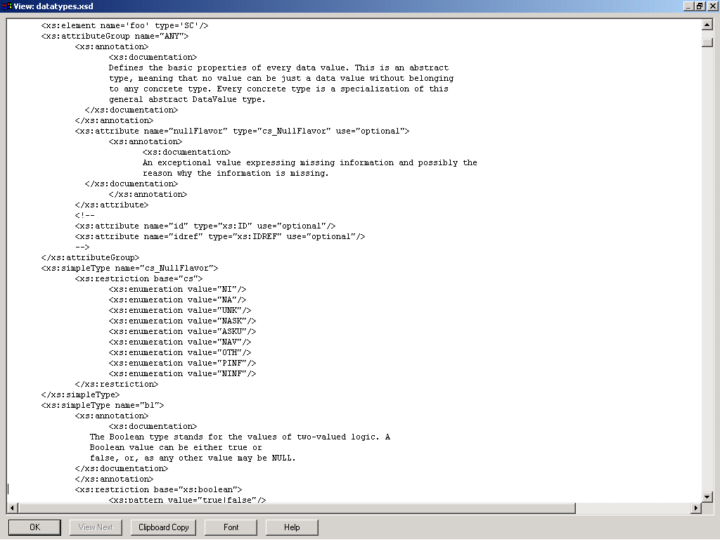
Datatype Schema

Slide 131
HL7 Version 3.0
Vocabulary Specification
The HL7 Vocabulary Specification defines the set of all concepts that can be taken as valid values in an instance of a coded attribute or message element.

Slide 132
HL7 V3 Vocabulary Specification
The HL7 V3 Vocabulary Specification defines vocabulary domains used in RIM coded Attributes and coded data type properties.
A vocabulary domain is an abstract collection of interrelated concepts. It describes the purpose or intent of a coded attribute.
A value set is a collection of coded concepts drawn from a single code system. A vocabulary domain may be associated with many value sets.
A context expression provides a means of designating which value sets within a given domain are applicable for a given usage context.
A coded concept has a concept code assigned by the coding system and a concept designation which names the referenced concept.
A coded concept may be a parent concept for a collection of additional concepts within the same code system.

Slide 133
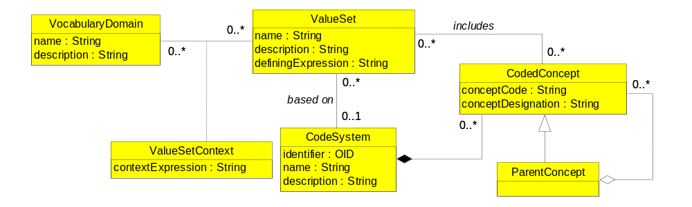
HL7 V3 Vocabulary Specification Metamodel

Slide 134
Vocabulary Metamodel Description
A vocabulary domain has a unique name and a description and is associated with zero, one, or more value sets.
If a vocabulary domain is associated with more than one value set, a value set context is used to specify the context under which each value set is relevant.
A value set is associated with zero, one, or more vocabulary domain. It has a name and description. A value set is a collection of coded concepts from a single code system.
The coded concepts included in a value set are drawn from a single coding system according to a defining expression. A value set’s defining expression defines what subset, projection, or partition of the code system concepts are within the scope of the value set.
The context expression describes the constraints, if any, governing the use of the value sets. Constraints include restrictions on jurisdictions, medical specialties, time periods, and other factors that together describe the context for which the value set is relevant.
Coded concepts have a concept code as assigned by the coding system and a concept designation. The coded concept designation is the name of the coded concept.
HL7 allows multiple designations for a coded concept, primarily to accommodate multiple languages. The PHDIM includes a single designation using the name of the concept in English.
A coded concept may be the parent concept of a collection of additional coded concepts. The parent concept is a generalization of the child concepts it collects. The parent concepts and its child concepts are part of the same value set.

Slide 135
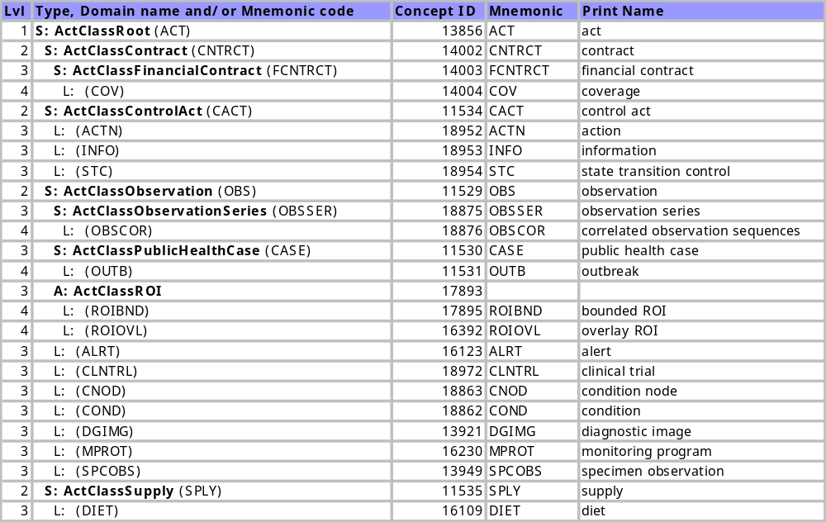
HL7 Vocabulary Table

Slide 136
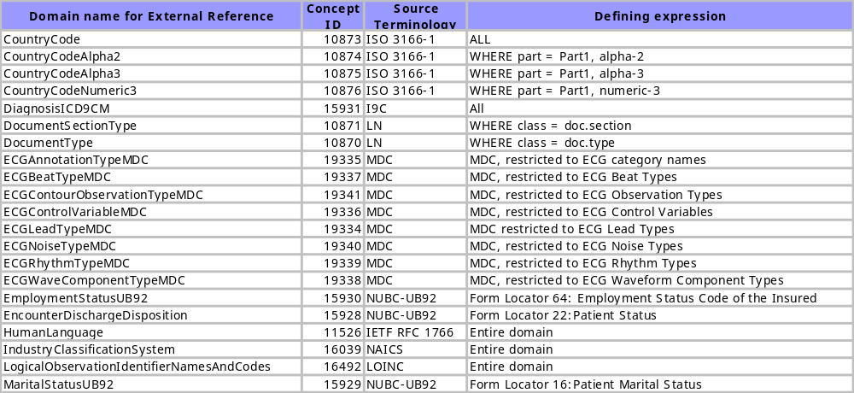
HL7 Reference to External Code Systems

Slide 137
Vocabulary Binding
Information Model
Vocabulary Binding
Vocabulary Terms
Class
Vocabulary
Domain
Code
System
0..1
1
0..*
0..1
1
0..*
0..*
0..*
0..*
0..*
Attribute
Value Set
Coded
Concept
0..*
0..1
0..*
0..*

Slide 138
Coded “Structural” Attributes
Act.classCode
Act.moodCode
Act.statusCode
ActRelationship.checkpointCode
ActRelationship.conjunctionCode
ActRelationship.joinCode
ActRelationship.splitCode
ActRelationship.Type
ActRelationship.contextControlCode
Entity.classCode
Entity.determinerCode
Entity.statusCode
ManagedParticipation.statusCode
Participation.contextControlCode
Participation.typeCode
Role.classCode
Role.statusCode
RoleLink.typeCode

Slide 139
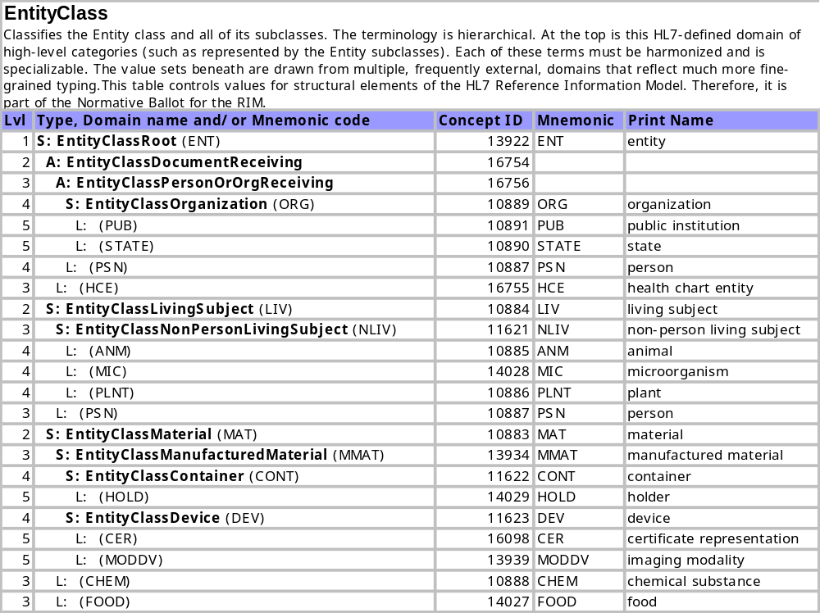
Entity.classCode

Slide 140
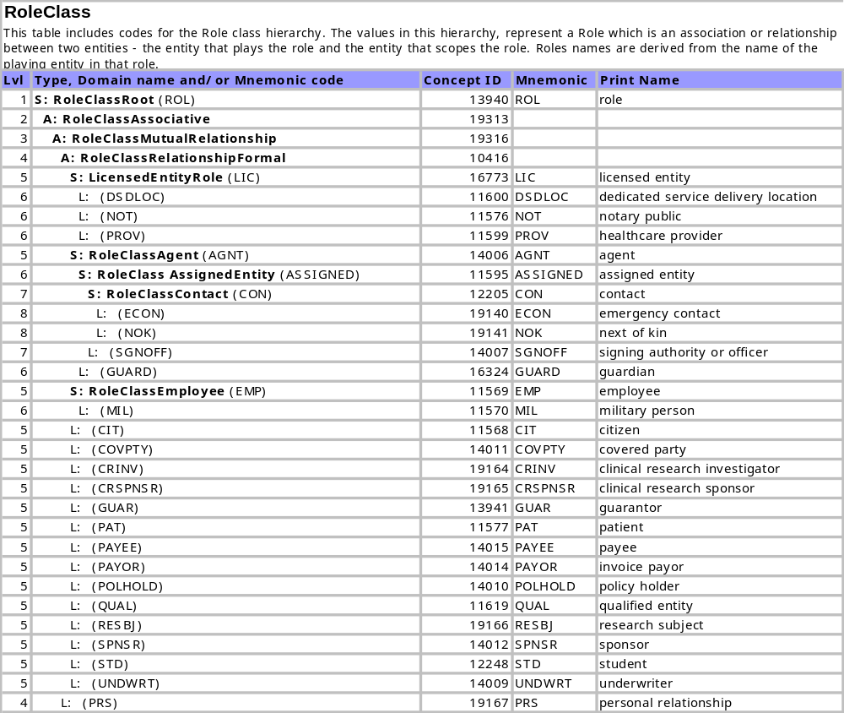
Role.classCode

Slide 141
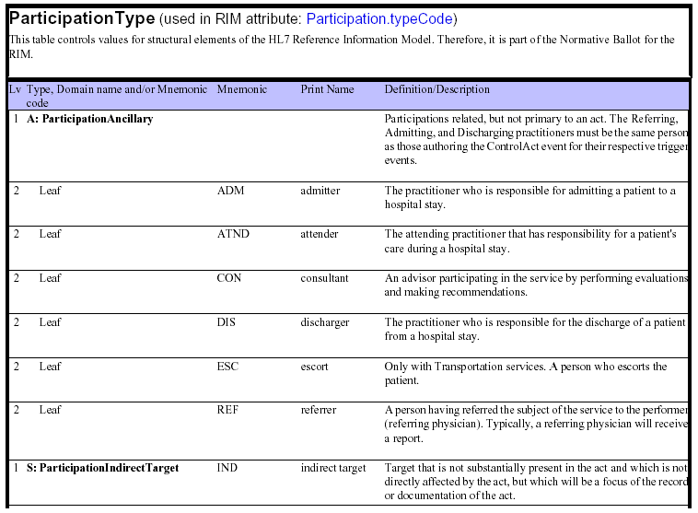
Participation.typeCode

Slide 142

Act.classCode

Slide 143
HL7 Version 3.0 Reference Models
Reference Information Model
Data Type
Specification
Vocabulary
Specification

Slide 144
HL7 Version 3.0 Reference Models

Slide 145

Questions / Discussion / Feedback

Slide 146
Thank You
Abdul-Malik Shakir
Principal Consultant
Shakir Consulting
1911 Foothill Blvd., Suite 148
La Verne, CA 91750
Office: (909) 596-6790 Mobile: (626) 644-4491
Email: AbdulMalik@ShakirConsulting.com

